Slide 1
How to Compare Fractions
Introducing:
Common Denominator

Slide 2
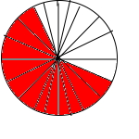
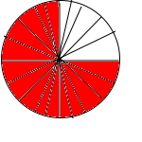
Compare Fractions 1
3 5
12 20
3 4
15 20
3 5
<
3 4
The common denominator of 5 and 4 is 20 because both 5 and 4 divide evenly into 20.

Slide 3
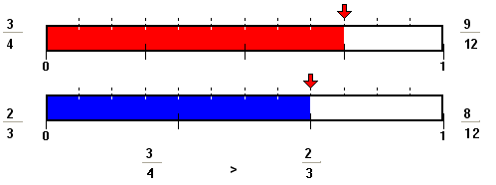
Compare Fractions 2
3 4
2 3
3 4
2 3
Here is the picture of and . The picture shows that is larger than . Notice that each fraction has been renamed to and .
9 12
8 12

Slide 4
Compare Fractions 3
Now that we know that 12 is the least common denominator for the fractions and , we can write each fraction with a denominator of 12
=
=
and are like fractions so now all we have to do is compare the numerators. Since 9 is greater than 8 the fraction is greater than .
3 4
2 3
3 4
x
3 3
9 12
2 3
x
4 4
8 12
9 12
8 12
9 12
8 12

Slide 5
Compare Fractions 4
In the fractions and
1. Multiply the larger denominator 4 by 2 to get 8. Does 3 divide evenly into 8? No.
2. Multiply the larger denominator 4 by 3 to get 12. Does 3 divide evenly into12? Yes, so 12 is a common denominator of the denominators 4 and 3.
3 4
2 3

Slide 6
Common Denominators: An example

Slide 7
Koko, Misu, and Tama decided to cross the lake. Koko rows of the trip while Misu rows of the trip. How much more does Tama need to row?
2 5
1 2

Slide 8
2 5
2 2
4 10
x
=
1 2
5 5
5 10
x
=

Slide 9
Misu and Koko rowed of the way. Tama still needs to row more of a mile to reach the other side of the river.
9 10
5 10
4 10
9 10
1 10
+
=
10 10
9 10
1 10
-
=

Slide 10
Compare Fractions 5
To compare fractions with unlike denominators rewrite the fractions with like or common denominators, making them like fractions.
3 12
5 12
3 12
5 12
The fractions and both have like denominators, making them like fractions.

Slide 11
To find a common denominator:
3 4
5 8
Think of the denominators 4 and 8 in and . Does the smaller denominator 4 divide evenly into the larger 8? Yes, then the larger denominator 8 is the common denominator.

Slide 12
If the smaller denominator does not divide evenly into the larger, multiply the larger denominator by 2, 3, and then 4, and so on. Each time check for division by the smaller denominator.

