Slide 1
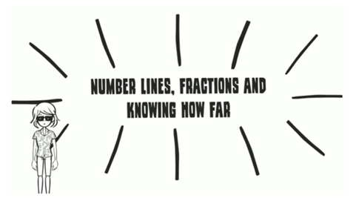

Slide 2
DID YOU EVER WONDER
WHAT GOOD ARE FRACTIONS?

