Slide 1
Mmm … doughnuts
adding fractions with like denominators

Slide 2
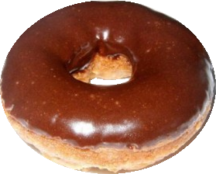
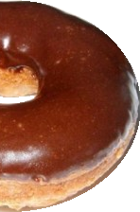
Let’s say you have a doughnut
Yum!
and you eat ½ of it

Slide 3
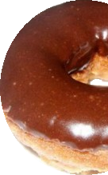
Now you only have ½ a doughnut

Slide 4
Your cousin has 1 ½ doughnuts, and you’re feeling kind of full, so you give her your half of a doughnut
1 ½ + ½ = 2

Slide 5
What if both you and your cousin had 1 ½ doughnuts?
1 ½ + 1½ = 3

Slide 6
Adding fractions
with like denominators

Slide 7
What’s a like denominator ?
“Like denominators”
and they are NOT like this
means the bottom numbers in the fractions you are adding are the same, like this:
¼ + ¾
2/3 + 3/5

Slide 8
Adding fractions
Fractions that have LIKE denominators are added exactly the same as whole numbers
1 + 1 = 2
½ + ½ = ²/2

Slide 9
Fractions that equal whole numbers
Whenever the numerator (top) and denominator (bottom) are equal, the fraction equals 1
4
4
= 1
9
9
= 1

Slide 10
Fractions that equal 1, in doughnuts
½ + ½ = ²/2 = 1

Slide 11
What are mixed numbers?
and how to add them

Slide 12
A mixed number
1²/3
6⁴/7
3²/3
includes a whole number and a fraction

Slide 13
How to add mixed numbers 1¹/3 + 2²/3
Add the fractions ¹/3 + ²/3 = 1
2. Add the whole numbers 1+2 = 3
3. Add your results from the first two steps 1 +3 = 4
1¹/3 + 2²/3 = 4

Slide 14
Two more points to know

Slide 15
You can switch the steps around and it still works …. 1¹/3 + 2²/3
1. Add the whole numbers 1+2 = 3
2. Add the fractions ¹/3 + ²/3 = 1
3. Add your results from the first two steps 3 +1 = 4
1¹/3 + 2²/3 = 4
Still

Slide 16
Sometimes the MIXED NUMBERS add up to another mixed number
It doesn’t matter. You still find the answer the same way

Slide 17
Sometimes the fractions add up to a mixed number 1¹/3 + 1¹/3
Add the fractions ¹/3 + ¹/3 = ²/3
2. Add the whole numbers 1+1 = 2
3. Add your results from the first two steps ²/3 + 2 = 2²/3

Slide 18
Mixed numbers, in doughnuts
Your doughnuts = 1¹/3
Cousin’s doughnuts = 1¹/3
1¹/3 +1¹/3 = 2²/3

