Slide 1
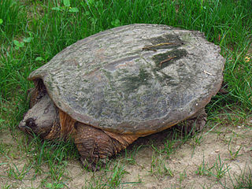
Multiplying fractions
With turtle eggs
Also, like denominators

Slide 2
Let’s say we have 15 turtle eggs

Slide 3
Fractions, Addition and Denominators

Slide 4
Multiplication, of course
3
x
1 = 3 15 15
What is adding the same thing over and over?

Slide 5
We took 3/15 of the eggs

Slide 6
The denominator is the bottom number in the fraction. One way to remember it is the denominator is down below and both Down and Denominator start with D.
2 9
Same denominators
1 4 7
9 9 9
Different denominators
4 4 1
9 11 12

Slide 7
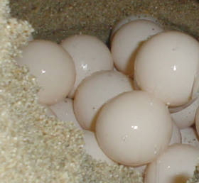
Denominator means: the number of parts
Denominator means more than "the number on the bottom".
It's the number of pieces that make up a whole.
So, if there are 15 eggs, one egg is 1 15
The number 15 on the bottom, the denominator, tells you how many eggs make up the whole nest of turtle eggs.
Yes, these are actual turtle eggs

Slide 8
Multiplying fractions (again)
A turtle lays her eggs in three lines of five eggs each (she's a very strange mother turtle)

Slide 9
If we take 5 out of 15 eggs,
it is 5 15
because
We have 5 eggs (the numerator)
It takes 15 eggs to make up the whole (the denominator)
Notes:
We have 5 eggs (the numerator, that is, the number of parts we have)
It takes 15 eggs to make up the whole (the denominator)

Slide 10
If we take 5 out of 15 eggs,
it is also 1 3
because
if we think of our whole nest of eggs as 3 lines, 3 would be the number of parts to make a whole (denominator), and 1 would be the number we have (numerator).
Notes:
We have 5 eggs (the numerator, that is, the number of parts we have)
It takes 15 eggs to make up the whole (the denominator)

Slide 11
Let’s say 1/3 of the eggs was just enough for grandfather
But then two people came to visit

Slide 12
3 x
= 1
1 = 3 3 3
If we take 1/3 of the eggs 3 times
We have taken 1 whole nest full of eggs
Notes:
We have 5 eggs (the numerator, that is, the number of parts we have)
It takes 15 eggs to make up the whole (the denominator)

Slide 13
What if THREE people came to visit?
Then there would be 4 people altogether

Slide 14
4 x
= 1
1 = 4 3 3
1 3
We already ate all of the eggs in 1 whole nest
But I’m hungry
Notes:
We have 5 eggs (the numerator, that is, the number of parts we have)
It takes 15 eggs to make up the whole (the denominator)

Slide 15
We need 2 nests
We take 1 whole nest of eggs
And 1/3 of a 2nd nest
Notes:
We have 5 eggs (the numerator, that is, the number of parts we have)
It takes 15 eggs to make up the whole (the denominator)

Slide 16
