Slide 1
Adding fractions with unlike denominators
12 20
Introducing:
Common Denominator
3 5

Slide 2
You know how to add problems with the same denominator, like this
3 5
1 5
4 5
=
+

Slide 3
But what about problems like this?
3 5
1 4
? ?
=
+

Slide 4
Before you can add or subtract fractions …
You need to find a common denominator

Slide 5
HOW do you find the common denominator?
No, you don’t find it by looking under a bush!
Stop that!

Slide 6
A common denominator is
When fractions have the SAME denominator, that is, they have the denominator in common

Slide 7
To find common denominator
Would you stop that!

Slide 8
To find common denominator
You need to find a number that is a multiple of each of the denominators.

Slide 9
To find common denominator
Another way of saying that is that you need to find a number that can be divided by both of the denominators

Slide 10
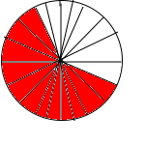
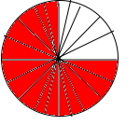
AN EXAMPLE
3 5
12 20
3 4
15 20
The common denominator of 5 and 4 is 20 because both 5 and 4 divide evenly into 20.

Slide 11
AN EXAMPLE
3 5
12 20
4 4
x
3 4
15 20
Multiply the NUMERATOR AND DENOMINATOR by the same number to get an equivalent fraction

Slide 12
AN EXAMPLE
3 5
12 20
3 4
5 5
15 20
x
Multiply the NUMERATOR AND DENOMINATOR by the same number to get an equivalent fraction

Slide 13
It’s called an EQUIVALENT fraction because it’s equal (another
word for equivalent). It’s the SAME.
3 4
5 5
15 20
x

Slide 14
It’s called an EQUIVALENT fraction because it’s equal (another
word for equivalent). It’s the SAME.
3 4
5 5
15 20
x
3 4
15 20
Whether we call it or
it’s still one and the same fraction

Slide 15
Don’t let this trip you up!

Slide 16
3 5
4 4
12 20
x
3 4
5 5
15 20
x
The two different fractions are multiplied by different numbers.

Slide 17
Because 5 x 4 = 20 But 4 x 5 = 20
3 5
4 4
12 20
x
3 4
5 5
15 20
x

Slide 18
Think about it for a minute.
No, seriously. Think about it. I’ll wait.

Slide 19
Common Denominators: An example

Slide 20
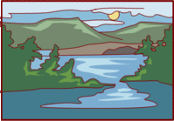
Koko, Misu, and Tama decided to cross the lake. Koko rows of the trip while Misu rows of the trip.
1 2
2 5

Slide 21
Koko, Misu, and Tama decided to cross the lake. Koko rows of the trip while Misu rows of the trip.
1 2
2 5
What fraction of the lake have they rowed?

Slide 22
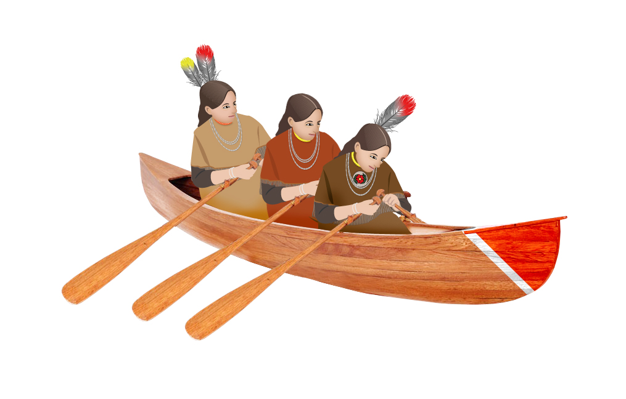
2 5
2 2
4 10
x
=
1 2
5 5
5 10
x
=

Slide 23
5 10
4 10
9 10
+
=
LAZY !

Slide 24
To find a common denominator:
3 4
Think of the denominators 4 and 8 in and . Does the smaller denominator 4 divide evenly into the larger 8? Yes, then the larger denominator 8 is the common denominator.
5 8

Slide 25
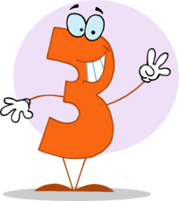
If the smaller denominator does not divide evenly into the larger, multiply the larger denominator by 2, 3, and then 4, and so on. Each time check for division by the smaller denominator.

