Slide 1
Reading a bar graph

Slide 2
Let’s look at the parts of our bar graph.
This line (y-axis) represents the pounds (lbs) of maize.
This line (x-axis) represents one ounce (oz) of the certain good.

Slide 3
So we label our graph like this:
50
40 y-axis that represents the pounds of maize
30
20
10
0
lbs of maize

Slide 4
So we label our graph like this:
50
40
30 x axis that represents one ounce of the certain good
20
10
0
feathers salt beans gold obsidian
one oz of goods
lbs of maize

Slide 5
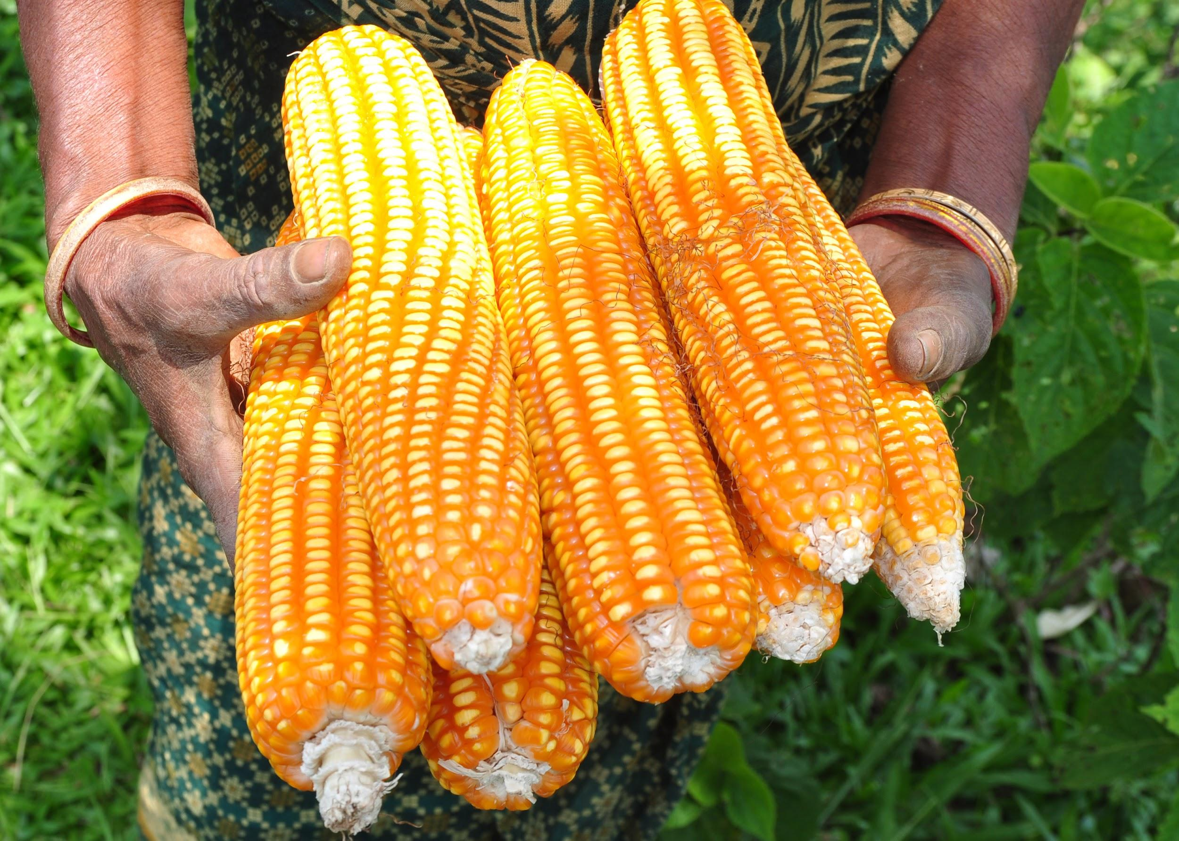
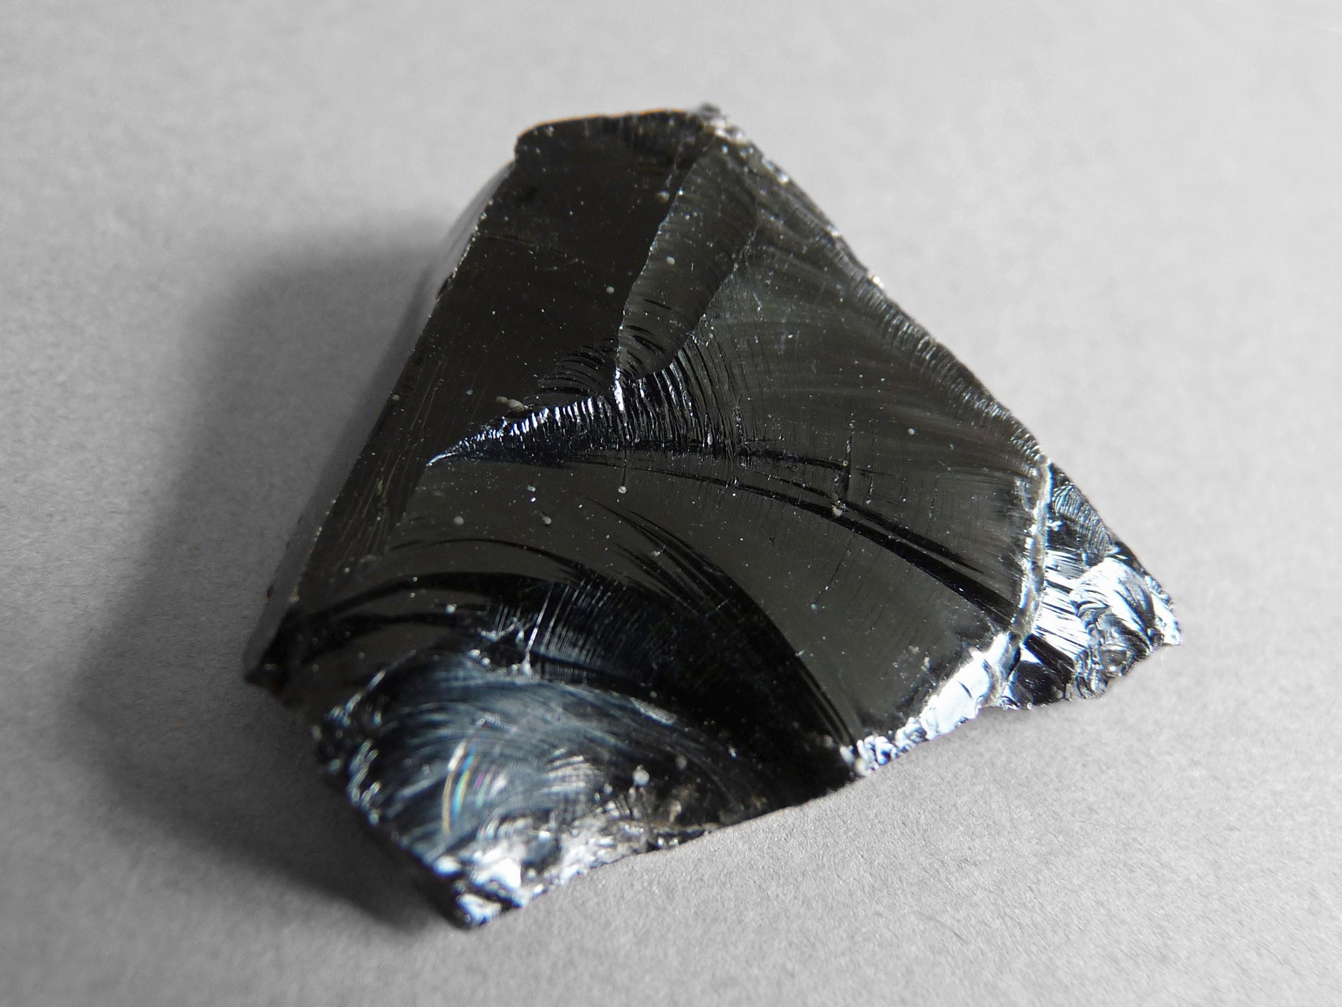
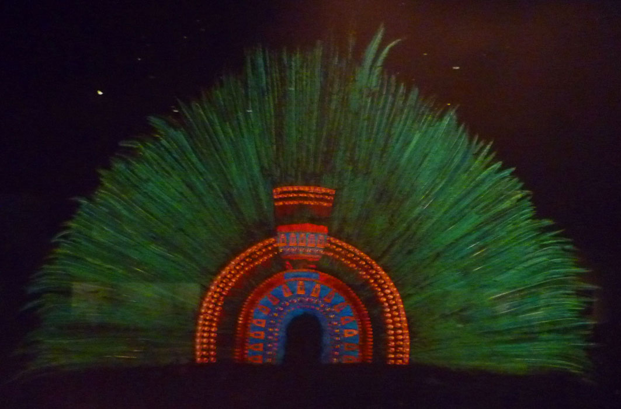
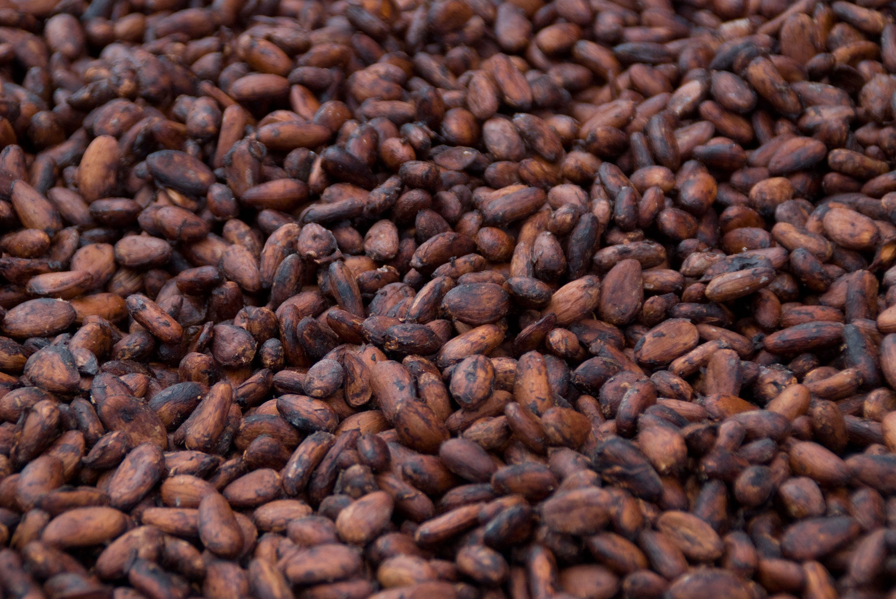
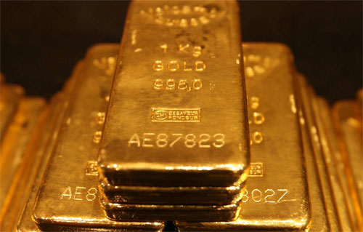
We need to remember the trade values. Let’s break it down...
1 oz quetzal feathers | 50 lbs maize
1 oz salt | 1 lb maize
1 oz cacao beans | 2 lbs maize
1 oz gold | 20 lbs maize
1 oz obsidian | 5 lbs maize

Slide 6
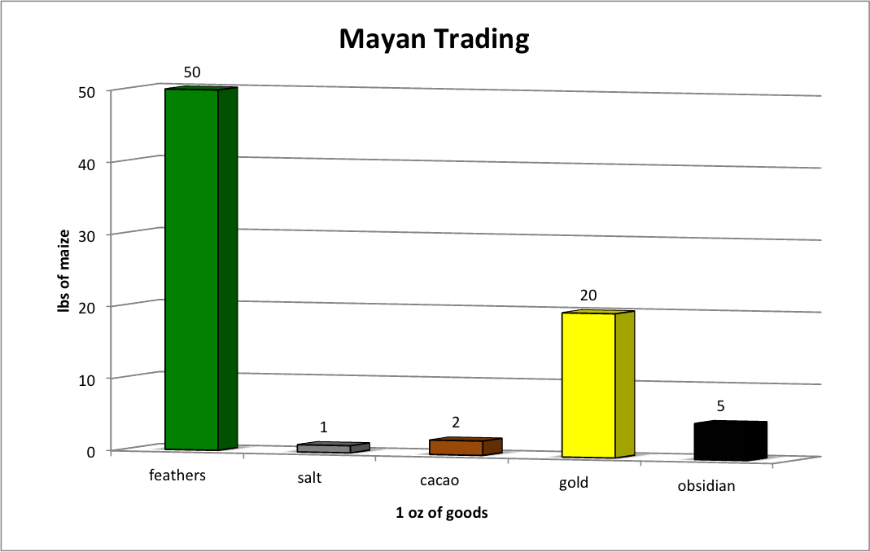
Then, we graph our trade values from the problem.
y-axis
x-axis

