Slide 1
The roles of home, school and culture in predicting achievement: Why we wrote the Spirit Lake game
AnnMaria De Mars, President The Julia Group
Erich Longie, President Spirit Lake Consulting, Inc.

Slide 2
It happened in a moment of weakness …
Hey! Let’s apply for this award to go to Washington, D.C. and analyze the National Indian Education Study

Slide 3
So, we went to Washington & here is what we found out ….

Slide 4
Indian Children Start Out Equal …
Notes:
Data from the Early Childhood Longitudinal Study, Birth Cohort. Comparisons at age 9 months. P. 65 Status and Trends in the Education of American Indians Alaskan Natives. On basic performance skills like exploring objects, problem solving and naming objects they are on par with non-Indian children

Slide 5
They start to lag by two years
% achieving task at two years of age
Notes:
On early precursors to mathematics such as matching and counting, American Indian/ Alaskan Native children have fallen behind by age two. Data from the Early Childhood Longitudinal Study, Birth Cohort P. 67 Status and Trends in the Education of American Indians Alaskan Natives.

Slide 6
The deficits still exist at grades 4 & 8

Slide 7
In 4th grade, AI/ AN children are lower in every category of mathematics

Slide 8
In 8th grade, AI/ AN children are STILL lower in every category of mathematics

Slide 9
At grade 8, more AI/AN students are far off the college preparatory path

Slide 10
Our story so far …

Slide 11
Deficits in mathematics …
Begin early
Are persistent
Are pervasive across mathematics domains
Are not limited to one method of measurement
Are not limited to a single survey

Slide 12
The question is …
WHY
What explains this difference in mathematics achievement?

Slide 13
Grade 8 Math Scores by Mother’s Education
Notes:
So, scores do go up with parental education but the gap is not closed. As parents with less education have children who do worse in school part of the difference may be due to this SES factor. Also, note that we do know that AI/ AN parents are less likely to have graduate degrees so that comparison by college graduate is not exactly equal education, as non-Indians include a larger percentage of people with graduate degrees

Slide 14
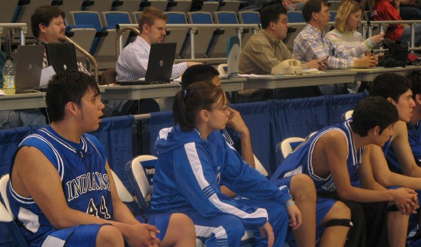
What else explains achievement?
It’s really complicated ….

Slide 15
Correlates of achievement
Absenteeism –
Density of American Indian/ Alaskan Native students –
Parent’s education +
Books in home +
Computer at home +
Knowledge of culture –
Teacher absenteeism -

Slide 16
In summary
Many variables correlate with achievement and nearly all of those variables are correlated with one another so ….

Slide 17
Early on, children are doing well
What happens by fourth grade?

Slide 18
Factors affecting achievement
Family dysfunction
Divorce
Large families in short time
Loss of grandparents
School dysfunction
Teacher absenteeism
Lack of strong administration
Dysfunctional boards
Student dysfunction
Student absenteeism
Student discipline problems

Slide 19
Our research design
Create school factor
Create home factor
Create student factor
Create cultural factor
Predict achievement from cultural factor controlling for school, student and home factors

Slide 20
Need for further research
Using only survey research, it is difficult to disentangle the effects of a cultural program from the many community, school, home, student and teacher factors. Therefore, we propose a quasi-experimental design with a pre-test, post-test, experimental and comparison group to control for the effect of these factors and test the impact of culture

Slide 21
NIES Analyses
We looked at predictors of mathematics achievement based on Bronfenbrenner’s theory of development with family, school and culture variables

Slide 22
Tried to create 3 scaled scores
Cultural values score had high reliability
School climate score had adequate reliability
Family environment score had poor reliability so mother’s education was used instead

Slide 23
Used multiple regression analysis
Culture score was significant but NOTE !! – it is coded so that lower scores mean less cultural activities, .e.g. “Do you speak your language at home?” 1= Yes 2 =No
Mother’s education was significant
School climate was significant
Student absenteeism was significant

Slide 24
Children in better schools perform better (duh!) but cultural activities DON’T always help
On the contrary, they can be negative. WHY?

Slide 25
Why culture activities don’t help
Simply put, we believe they are taught wrong. They are not integrated with the curriculum so they are taking time AWAY from mathematics
Within this sample, there was not a significant correlation between school and culture variables, so the negative relationship is NOT due to the fact that lower SES, poorer performing schools are including cultural activities

Slide 26
Not willing to choose between culture and academic achievement
We submitted a proposal to USDA to develop a computer game to teach language, culture and mathematics

