Slide 1
Adding Fractions
With Like Denominators

Slide 2
Adding Like Fractions
Like Fractions have the same Denominator

Slide 6
How does that help you?
Like fractions are EASY to add!
Just add the Numerators

Slide 7
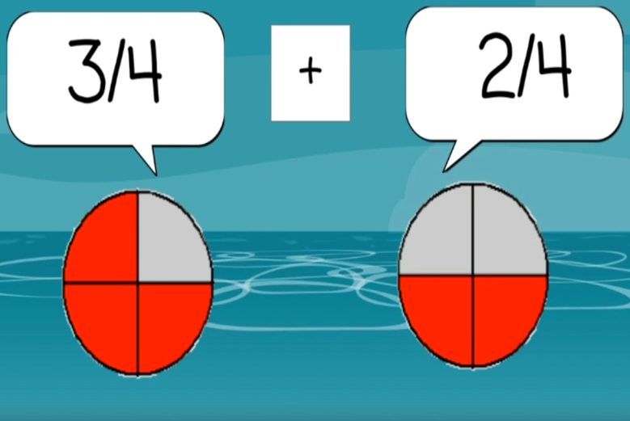

Slide 8
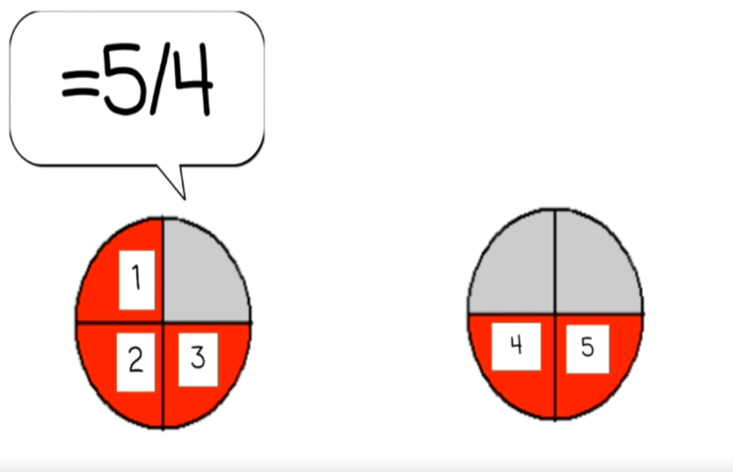

Slide 9
Example

Slide 10
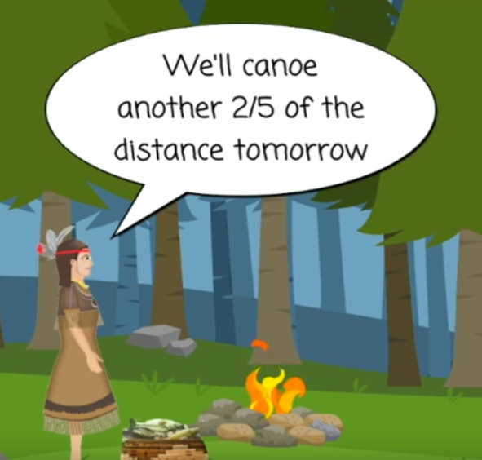

Slide 11
What Fraction of the Distance will they have canoed in 2 days?

Slide 12
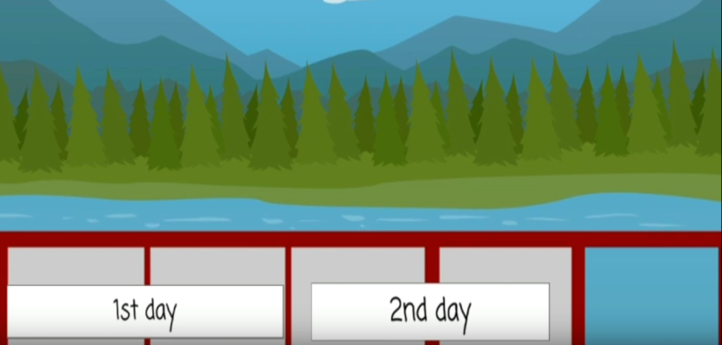
2/5
+
2/5

