Slide 1
Compare Unlike denominators

Slide 2
Step 1
Compute the fraction from last year.
25 Fish over 1 foot long.

Slide 3
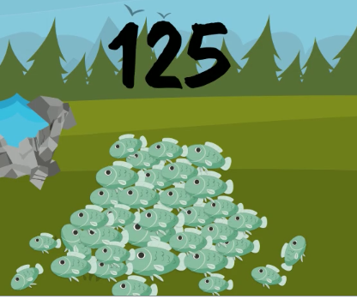
Step 1
Total number of fish caught was 125

Slide 4
Step 1
Our Fraction is:
25
125

Slide 5
Step 2
Reduce the fraction
25 and 125 can be divided by 25
25÷25 = 1
1
5
=
125 ÷25 = 5

Slide 6
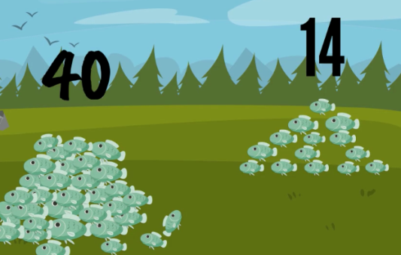
Step 3
Compute the fraction from this fishing trip
Find the fraction of fish over 1 foot long that you caught this year.
14
40
Over 1 foot long

Slide 7
Step 4
14
40
Reduce the Fraction
14 and 40 can be divided by….
2
14 ÷ 2= 7
7
20
=
40 ÷ 2= 20

Slide 8
Step 5
Compare the fractions
Which is greater?
1 Or 7
5 20
Find the Least Common Multiple

Slide 10
What is a multiple?
Multiples of a number = the numbers you get when you multiply
it by other numbers.
For example: 8, 16, 24, 32, are all multiples of 8

Slide 12
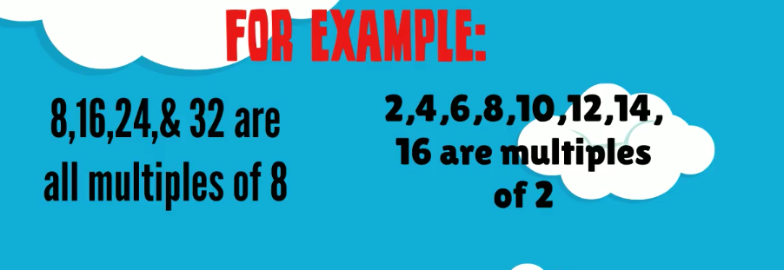
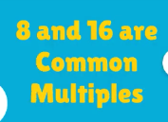
Common Multiple
When 2 numbers have a common multiple it means that the same
number is multiple of both of them

Slide 13
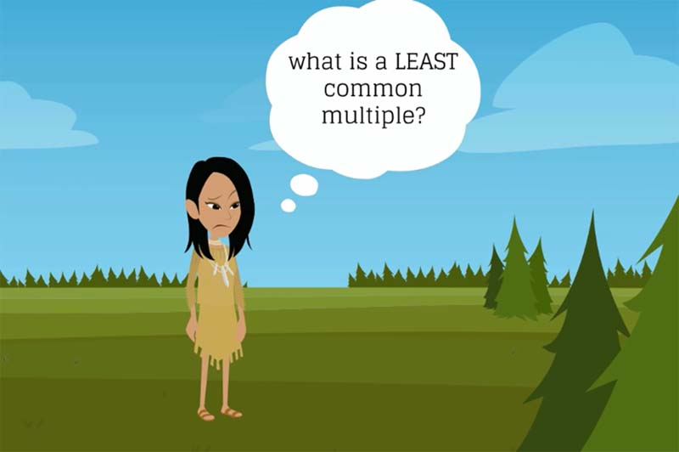

Slide 14
Least Common Multiple:
The lowest number that is a common multiple

Slide 15
Going back to the fish problem…
1 Or 7
5 20
Find the least common multiple of 5 and 20

Slide 16
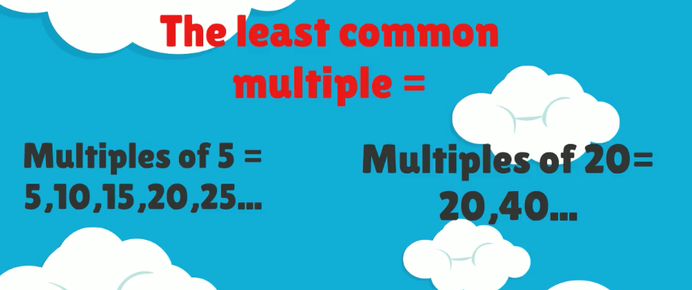
The least common multiple is:
20

Slide 17
Multiply the denominator, 5, to equal 20
What you do to the bottom number,
you do to the top number equally.

Slide 19
And then we changed our fraction 1/5…

