Slide 1
How to do Long division
Part 1

Slide 2
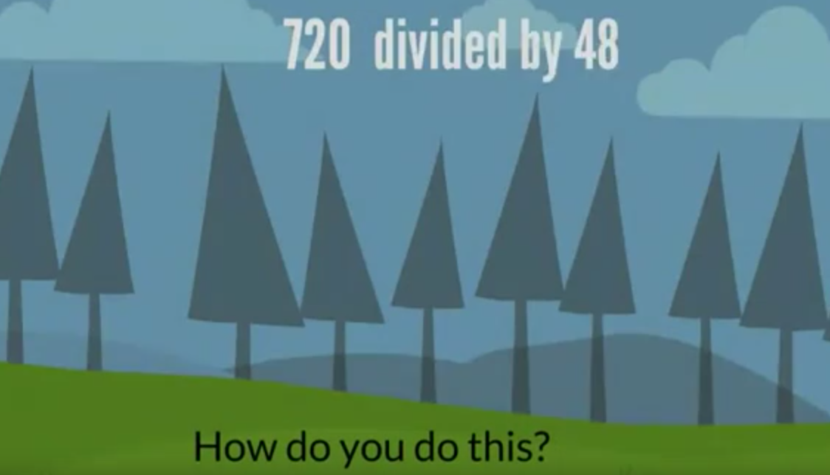

Slide 3
So how do you solve that division problem?
GUESS!!

Slide 4
Example
Guess
1
5
42
21
0
210
0

Slide 5
Test it!
42
X 15
210

