Slide 1
Multiplying Fractions
Also, like denominators

Slide 2
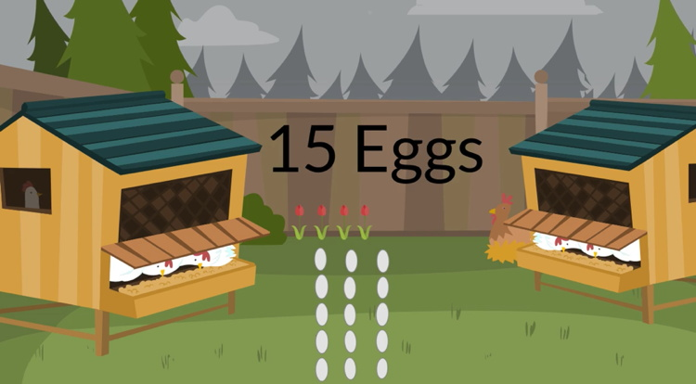
Let’s Say we have:

Slide 3
Fractions, Additions and Denominators
There are 15 eggs. If you take 1 egg, the fraction is: 1/15
If you took 3 eggs, that is:
1/15 + 1/15 + 1/15

Slide 4
Fractions, Additions and Denominators
If fractions have the same denominator then you add them
just like whole numbers
1/15 + 1/15 + 1/15 =
3/15

Slide 5
What do you call when you add the same thing over and over?
MULTIPLICATION!
1/15 + 1/15 + 1/15 =
3 x 1/15

Slide 6
The Denominator is the bottom number
of the fraction. Once way to remember this is
that the Denominator is down below
and both the word Denominator
and Down start with the letter D

Slide 7
2
9
Denominator
Same Denominator:
1 4 7
9 9 9

Slide 8
Different Denominator:
4 4 1
9 11 12

Slide 9
Denominator:
Number of parts
More than just “ the number on the bottom”
Is the number of pieces that make a WHOLE

Slide 10
Denominator means the number of parts
If there are 15 eggs, then 1 egg is : 1/15
The number 15 on the bottom, the denominator, tells you how many
Eggs make up the whole nest of chicken eggs

Slide 11
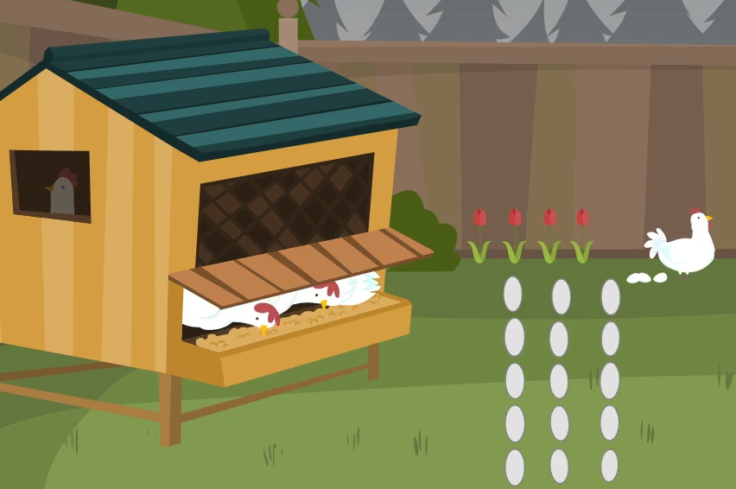
Multiplying Fractions
Let’s say a chicken lays her eggs in 3 rows of 5 eggs each

Slide 12
5
15
If we take out 5 of the 15 eggs it is:
Because:
1. We have 5 eggs- the Numerator

Slide 13
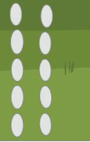
5
15
If we take out 5 of the 15 eggs it is:
Because:
1. We have 5 eggs- the Numerator
2. It takes 15 eggs to make the whole- the Denominator

Slide 14
5 out of 15 is also 1/13
If we think of the whole nest as 3 lines, 3 would be the number
of parts to make the whole ( denominator) and 1 would be
the number of lines we have taken ( the numerator).

Slide 15
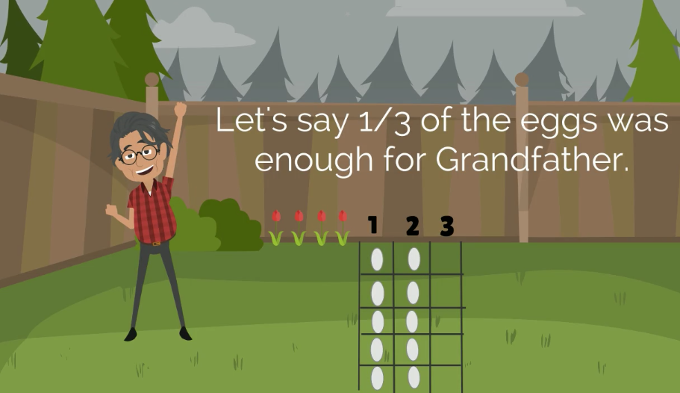

Slide 16
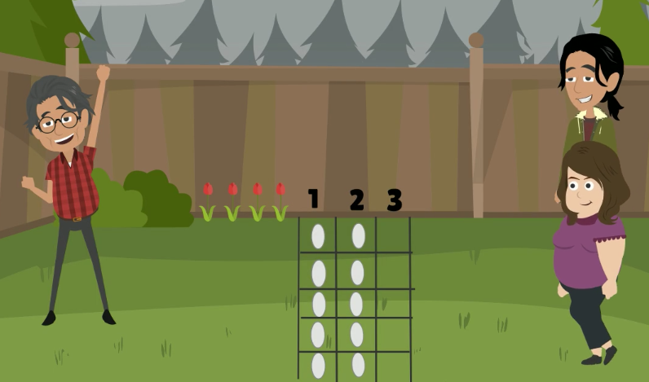
But then 2 people showed up

Slide 18
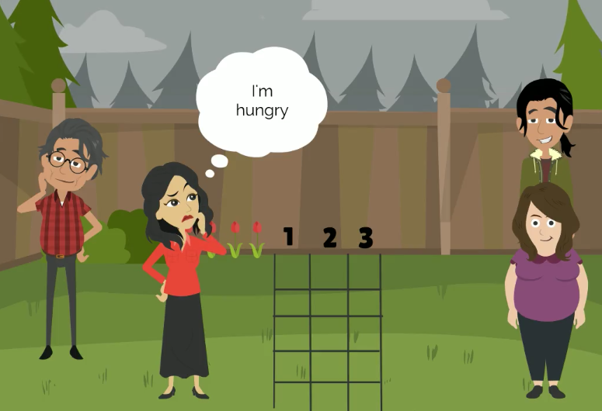
What if 3 people came to visit?

Slide 19
We already know a whole nest.. = 3/3= 1
If there are 4 people we would need:
4 x 1/3=
4/3
1 1/3

Slide 20
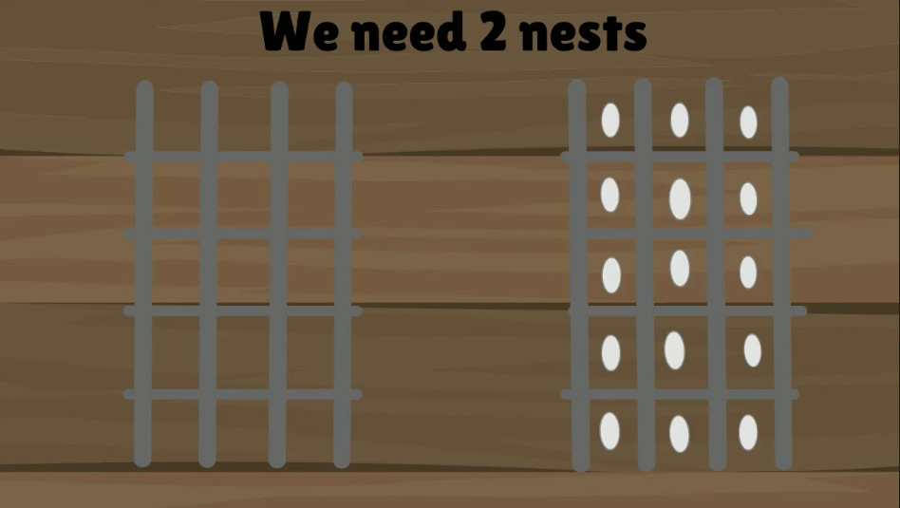
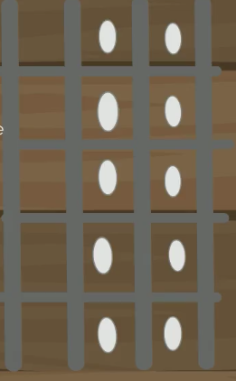
We already took 1 whole
nest of eggs.
And now 1/3 of the other
4/3 = 1 1/3

