Slide 2
Problem-Solving Strategy
Build a Model
One way to solve a problem is to build a model.

Slide 3
Build A Model
Take your math problem and build a model out of the information given.

Slide 4
Example
You are moving with your tribe across the plains and you need to pack buffalo robes to trade. Each cart will hold 12 robes and you have 5 carts to fill. How many buffalo robes can you pack?
Build a Model!

Slide 5
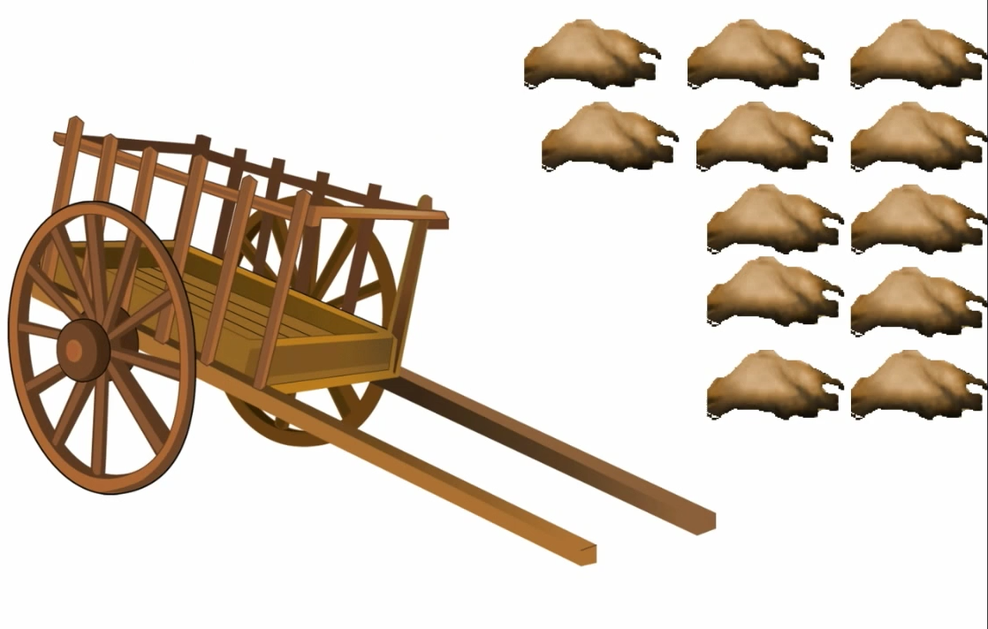
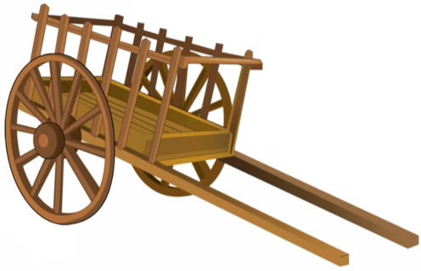
1 cart can hold 12 robes.
We have 5 carts.

Slide 6
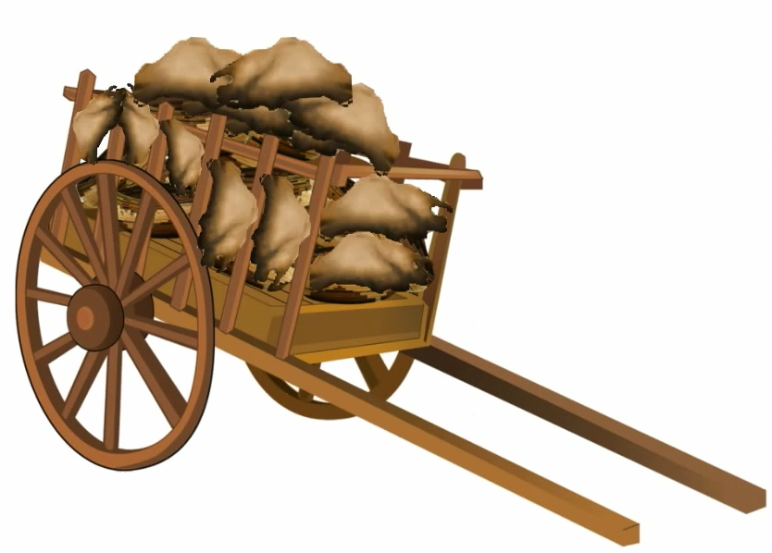
Each cart holds 12 robes.
How many robes do we have?
12 + 12 + 12 + 12 + 12 = ?
5 x 12 = ?
60

Slide 7
Another example
This doesn’t just have to be with robes. You can use this strategy for anything.
Your teacher asks your class to pack up the books to move to another classroom.

Slide 8
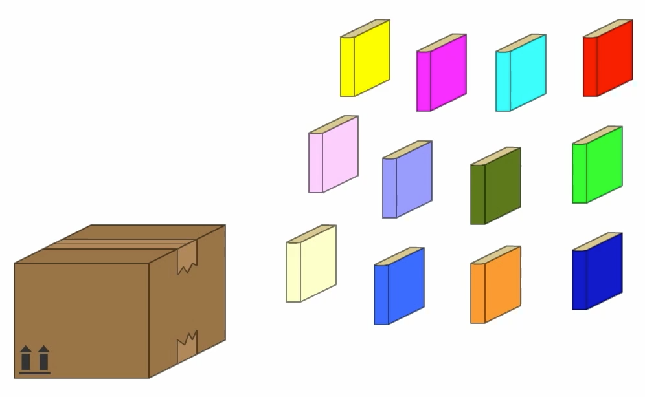
You can fit 12 books into one box.

Slide 9
1
2
3
4
5
You need to pack up 5 boxes.
12 + 12 + 12 + 12 + 12 = ?

Slide 10
12 + 12 + 12 + 12 + 12 =
OR
12 x 5 =
60

Slide 11
Visit at
www.7generationgames.com

