Slide 1
Introduction to:
PROBABILITY

Slide 2
Probability
What are the chances of getting a certain outcome from an event?
Example #1: Flip a Coin
What are the chances of getting tails when you flip the coin?
How likely is it that you will get tails?

Slide 3
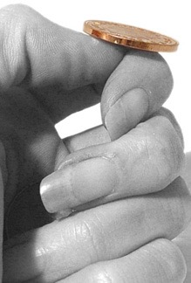
Probability Terms
Each time you flip the coin is one event , that is 1 time that you do something

Slide 4
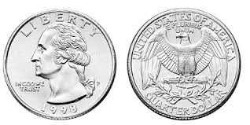
Each time you flip the coin…
There is an equal chance of getting heads or tails
There are two possible outcomes , an outcome is what happened

Slide 5
Probability is how likely something is to happen
With coins, unless you are cheating, probability of getting heads is 50%, that is ONE-HALF of the time your coin should land on heads

Slide 6
If the probability is 0, we say something is impossible
An IMPOSSIBLE event is one that never happens.

Slide 7
What is the probability that your coin will land on a flower?
The probability is ZERO.
We do not have flowers, just heads or tails.

Slide 8
What is the probability that your coin will land on a flower?
The probability is ZERO.
We do not have flowers, just heads or tails.
It is IMPOSSIBLE.
It will happen 0 times that your coin lands on a flower.

Slide 9
If the probability is 100%, we say something is certain.
A CERTAIN event is one that always happens.

Slide 10
What is the probability that a quarter will land on a side that is silver?
The probability is 100%.
Both sides are silver.
It will always happen that a quarter lands on a silver side.
It is CERTAIN.

Slide 11
Now let’s use what you know about PROBABILITY
with another example
Not with a coin but with…

Slide 12
Guinea Pigs!
Ex. #2

Slide 13
I have two guinea pigs. Both are girls.
Ex. #2

Slide 14
What is the probability, if I pick up a guinea pig that it would be a female?
?

Slide 15
The probability of getting a female guinea pig is 100%. It will always happen.

Slide 16
click here:
www.7generationgames.com

