Slide 1
Start at the End

Slide 2
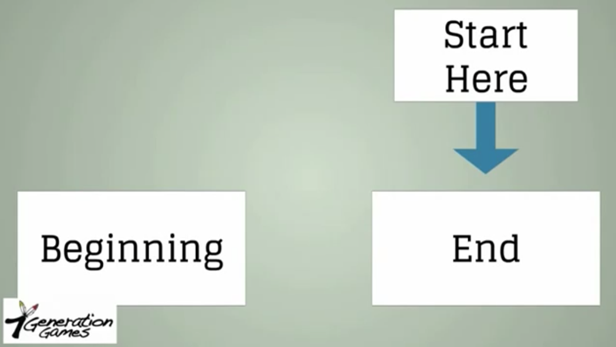
Problem-Solving Strategy: Start at the End
Almost always, the actual problem or the question that you are being asked to answer in a word problem will come at the very end of the word problem.

Slide 3
Problem-Solving Strategy: Start at the End
An Example

Slide 4
Problem-Solving Strategy: Start at the End
Sara
Devin
An Example
The problem that you are going to solve is:
What was the total cost of their lunch?

Slide 5
Problem-Solving Strategy: Start at the End
An Example

Slide 6
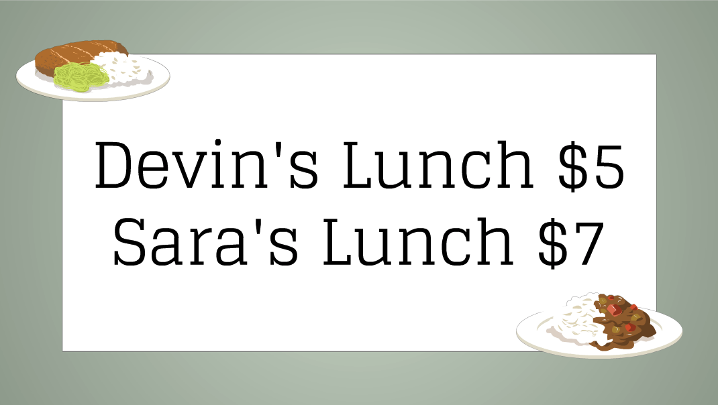
Problem-Solving Strategy: Start at the End
In this case, the information presented is the cost of Devin and Sara’s lunch.
Devin’s lunch $5
Sara’s lunch $7
The question that you are trying to answer or the problem that you need to solve is:
What was the total cost of their lunch?
An Example

Slide 7
Problem-Solving Strategy: Start at the End
We take the information given:
$5 + $7 = $12
The total cost of lunch
An Example

Slide 8
Problem-Solving Strategy: Start at the End
A Harder Example
Margot
Sara
Devin
Devin and Sara’s friend Margot joins them for lunch.

Slide 9
Problem-Solving Strategy: Start at the End
Here’s our problem:
Devin, Sara and Margot went to lunch. Devin’s lunch cost $4. Sara’s lunch cost $6 and Margot’s lunch cost $8. When the bill came, the friends decided to split it evenly three ways and each pay the same amount. How much should each person pay?
A Harder Example

Slide 10
Problem-Solving Strategy: Start at the End
Let’s go directly to the end:
How much should each person pay?
That’s the question that we need to answer.
A Harder Example

Slide 11
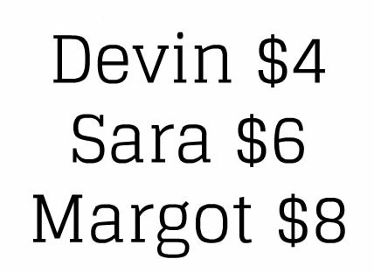
Problem-Solving Strategy: Start at the End
Again,
1. Presented with information.
A Harder Example
We are given the cost of each friend’s lunch and that they want to split the check evenly – 3 ways.

Slide 12
Problem-Solving Strategy: Start at the End
And,
2. Asked to answer a question related to the information.
The last part of the problem is the question that we have to answer.
How much should each person pay?
A Harder Example

Slide 13
Problem-Solving Strategy: Start at the End
This is a two step problem.
First, add the cost of each person’s lunch together.
$4 + $6 +$8 = $18
A Harder Example

Slide 14
Problem-Solving Strategy: Start at the End
Always make sure that you’re answering the question at the very end of your problem. That’s important!
Final Answer?
$18
A Harder Example

Slide 15
Problem-Solving Strategy: Start at the End
Always make sure that you’re answering the question at the very end of your problem. That’s important!
Final Answer?
$18
A Harder Example
That doesn’t answer the question being asked. There’s still one more step.

Slide 16
Problem-Solving Strategy: Start at the End
We started at the end to find the question that needed to be answered. That question will help us focus in on the right answer.
What we need to answer to solve the problem:
How much should each person pay?
A Harder Example

Slide 17
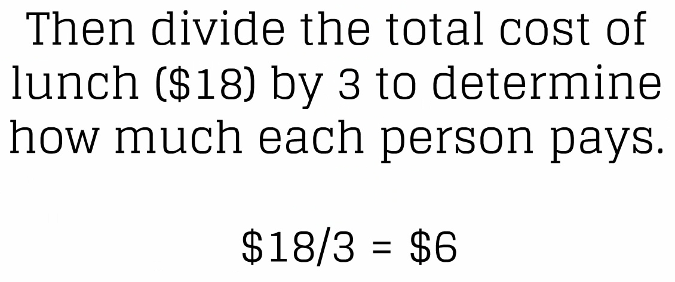
Problem-Solving Strategy: Start at the End
Second step:
A Harder Example

Slide 18
Problem-Solving Strategy: Start at the End
Tip #1
When you’re done, go back to the end and make sure you’ve answered the question the problem asks.
Two More Tips

Slide 19
Problem-Solving Strategy: Start at the End
Tip #2
To determine what you need to answer in a word problem:
Look for the sentence in the problem that ends with a question mark.
Two More Tips

Slide 20
Problem-Solving Strategy: Start at the End

Slide 21
Visit at
www.7generationgames.com

