Slide 1
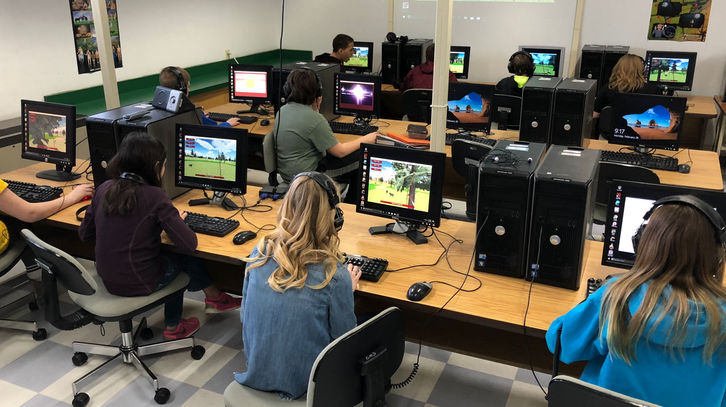

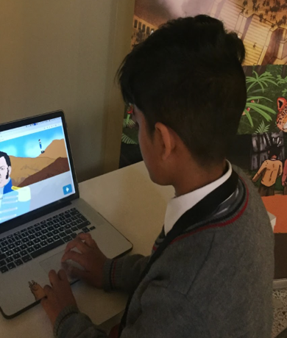
Games that make you smarter. Made smarter.
Notes:
We make educational games. Nearly all of our games teach math or science with an Indigenous or Latino history story line, because everyone has always used math and science. Our newest project is a no-code platform that lets anyone make an educational game.

Slide 2
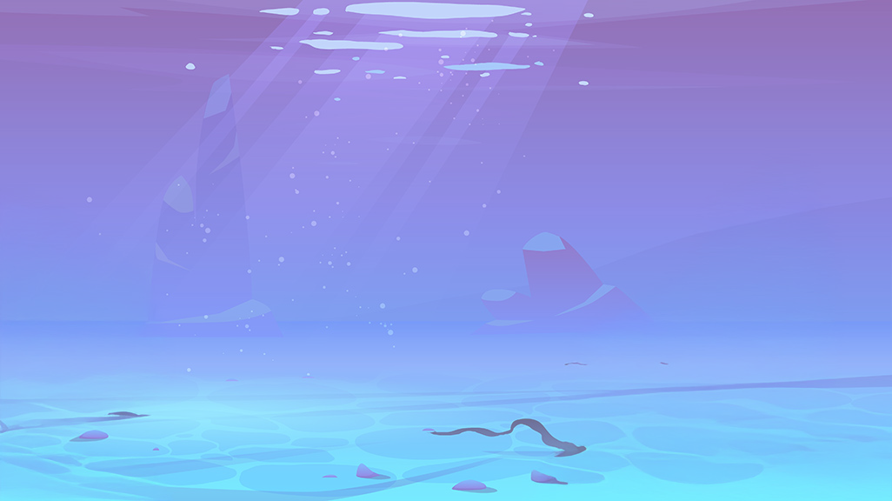

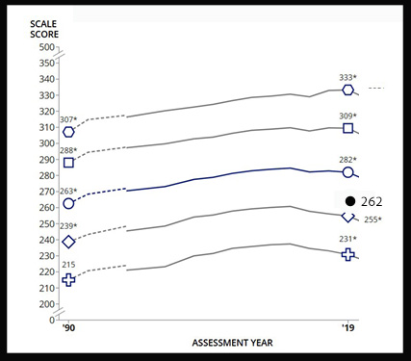
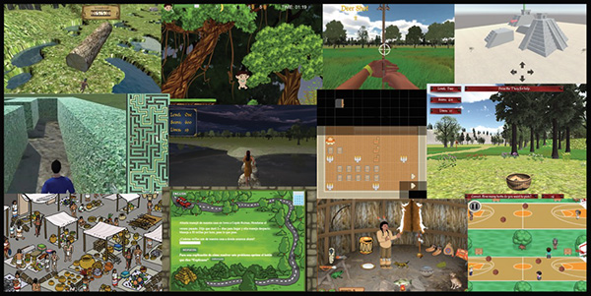
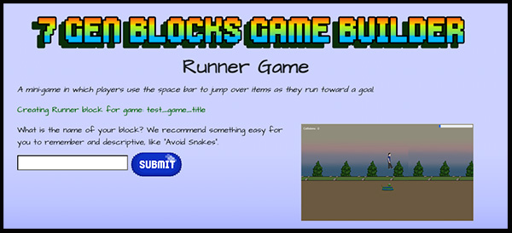
Notes:
I want to talk about our who, why, what and how. Who am I? – I’m president of 7 Generation Games, which makes educational games and game creation platforms, where I have been the lead developer on dozens of games. I’ve taught math at all levels from fifth grade through doctoral students. I was also Principal Investigator for the Growing Math project, with co-PI Juliana White Bull, which creates and distributes games and lessons teaching math and science in the context of Indigenous and Latino culture and history – all freely available at growingmath.org by the way. With Juliana, from Sitting Bull College and Dan Conn of Minot State University, I also led the Co-designing Games to Teach Indigenous and Rural History project with funding from the Library of Congress Teaching with Primary Sources program.

Slide 3
My plan (and I do have one)
1
2
3
4
WHY
HOW
PLAY
PLAN
we developed these games
the games impacted math scores
WHAT
we made
YOUR OWN GAMES
02
Notes:
Why we developed these games
How the games impacted math scores
What we made (play games!)
Your ideas on improving educational games
How to make your own games.

Slide 4
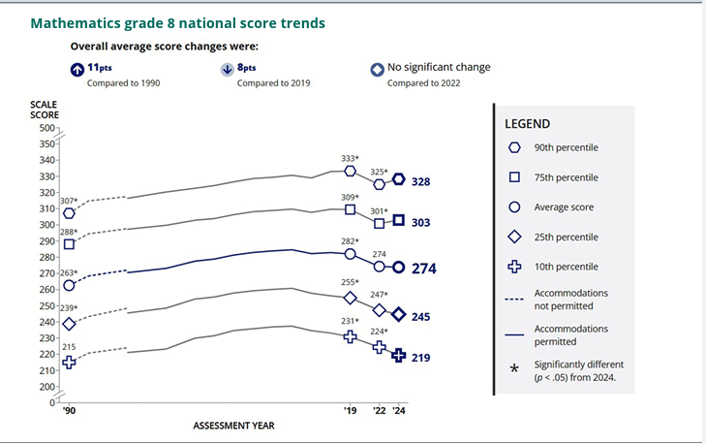
Notes:
I know the statistics from experience – over a third of 8th-graders are below basic in math, can’t find 40% of $15. Disparities are getting worse, NAEP scores of Latino and Native American students, and students in the lowest quartile dropped disproportionately during the pandemic and haven’t recovered
https://www.nationsreportcard.gov/reports/mathematics/2024/g4_8/supporting-files/summary-of-results.pdf

Slide 5
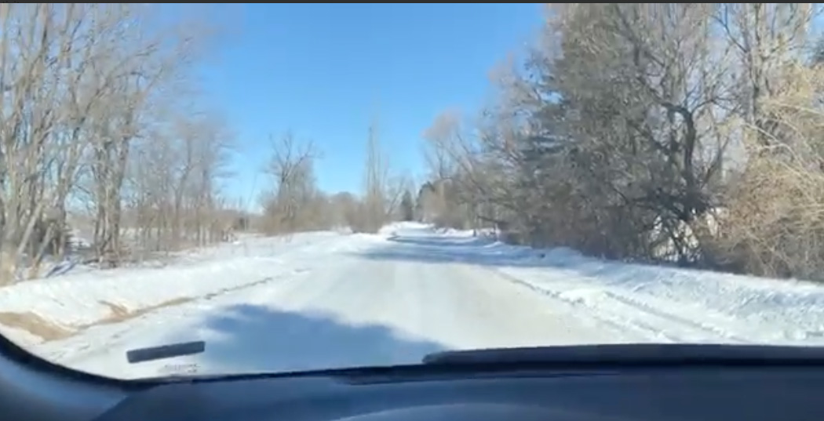
Careful what you wish for
Notes:
I said instead of sitting in our offices coming up with ideas about what teachers need, someone should go into classrooms and ask teachers. The folks who run the Vital Prize at the National Science Foundation agreed, so they gave us funding to go visit classrooms in North Dakota, South Dakota, Minnesota and Michigan in January and February. Did I mention that I live by the beach in Santa Monica? So, Juliana White Bull and Maria Burns Ortiz, who are my ride or die, went along with me through back roads, dirt roads, snow covered roads and places I’m not even sure WERE roads.

Slide 6
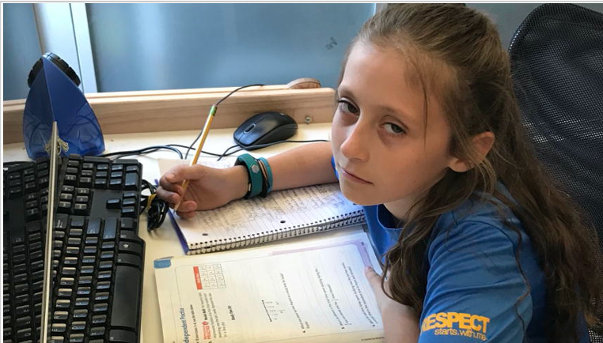

How games can be the answer
Attendance
Engagement
Differentiation
Need to educate the whole child
Notes:
In classrooms we visited, 10-50% of students turned in their worksheets with nothing written but their names
The major issues they identified :
Engagement – measured by increase in math problems completed with games over using worksheets - and if you look at our games like Making Camp Ojibwe, the content that is being taught, like multiplication facts or division facts, is similar to what students would be doing on a work sheet, but the difference is, students are DOING it.

Slide 7
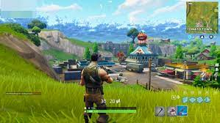
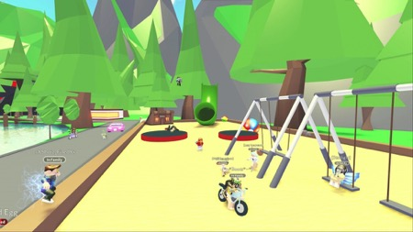
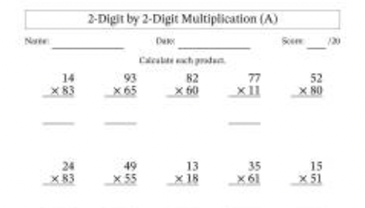
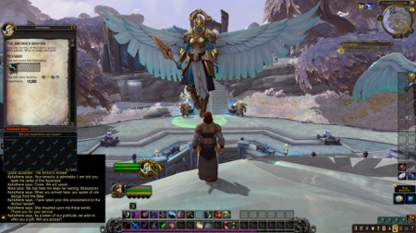
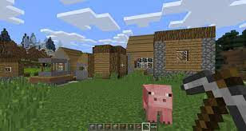
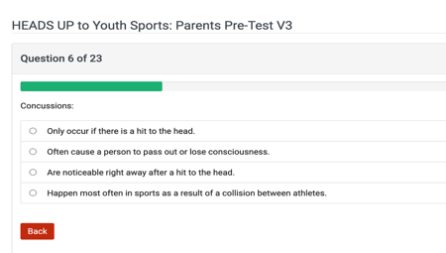
What we are replacing
NOT HERE
NOT HERE
HERE
Notes:
When I talk about what we are replacing at 7 Generation Games, I don’t mean mainstream gaming engines building World of Warcraft or Roblox. We are reconceiving the worksheet with a platform easy enough that games that can be made teachers or by students in coding classes. You can have your middle school students making games for your fourth-graders.

Slide 8
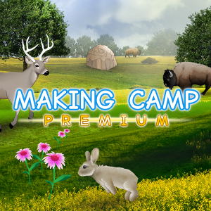
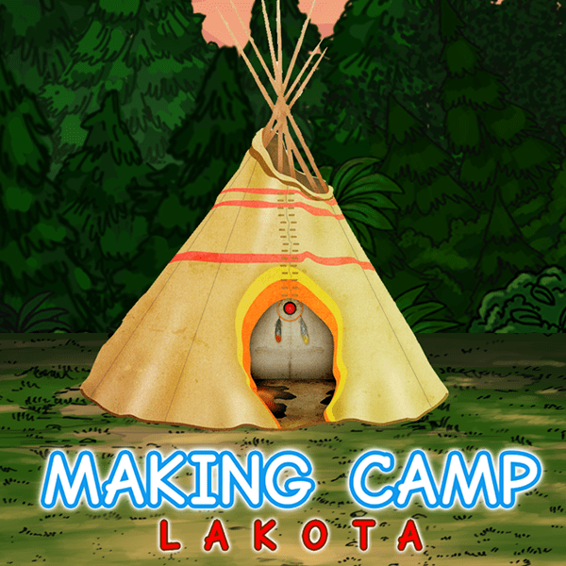
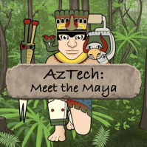
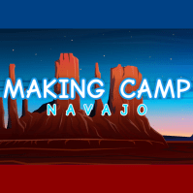
Start where the student is
Notes:
Because we make a lot of games, students can start at multiplication and work their way through. Students aren’t going to be engaged if they can’t do the work. Some students will whiz through the first suite of games, and others won’t

Slide 9
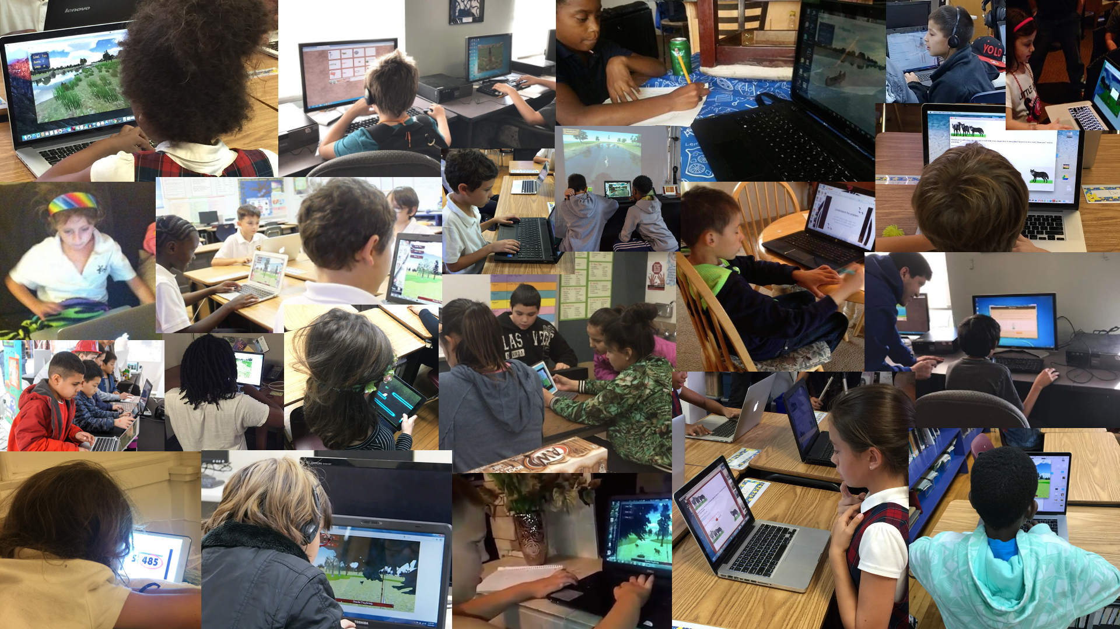
Time on task
Cross-curricular instruction = more class time
Notes:
More time comes from two sources – first of all, students are engaged, they’re spending more time on task . Second, when you have cross-curricular games where math or science is part of history class, like the science behind the three sisters method of agriculture or using cattails to stop bleeding or how much more weight can be pulled with a Red River cart – well it’s not too surprising that students learn more science and math

Slide 10
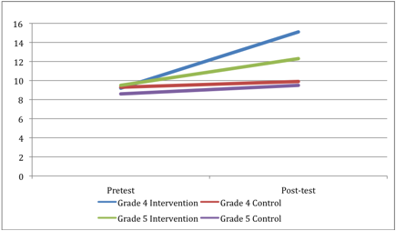
Published, Peer Reviewed Research Shows the Games work
Notes:
Published, Peer Reviewed Research Shows the Games work, with students using our games improved significantly on the standards taught compared to the control group, and those who played more improved more and I think there is a very simple explanation for that – time

Slide 11

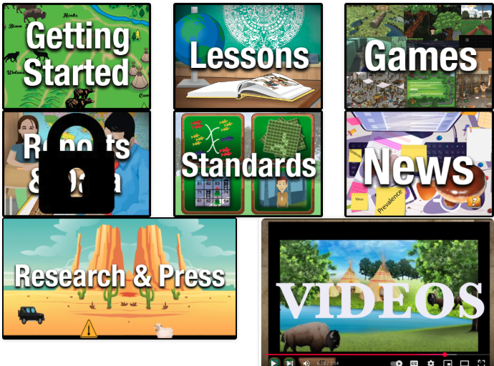
https://www.growingmath.org/games-for-growing-math/
Notes:
Let’s play some games. Pick a game. Be aware that you are going to play for 10 minutes and then give suggestions on how to make it better

Slide 12


Tell us how to improve
This Photo by Unknown Author is licensed under CC BY-NC-ND
https://forms.gle/YUH9KP4BgjqL6qsg8
Notes:
5 minutes to write your ideas

Slide 13

Our 7 Gen Blocks story began in the Upper Nicola Valley
Notes:
My friend, Melissa is enrolled in the Upper Nicola band and she asked me to come up and give a talk on using games to teach Indigenous languages

Slide 14
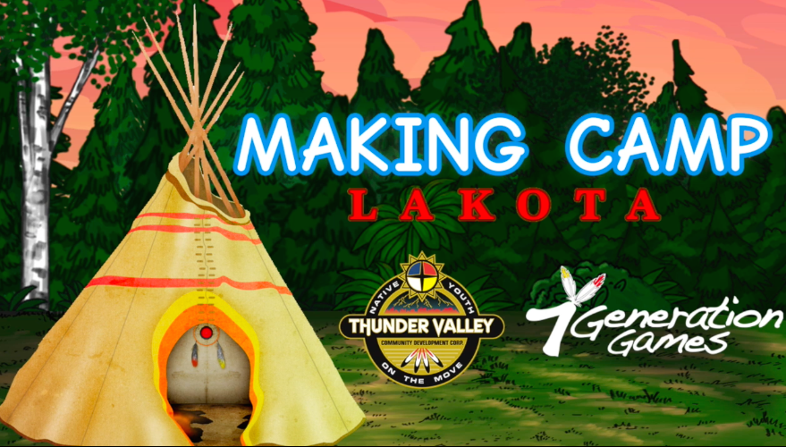
Notes:
We had done a game, Making Camp Lakota, with the Thunder Valley cooperative at Pine Ridge and she was interested in having us present the work we had done

Slide 15
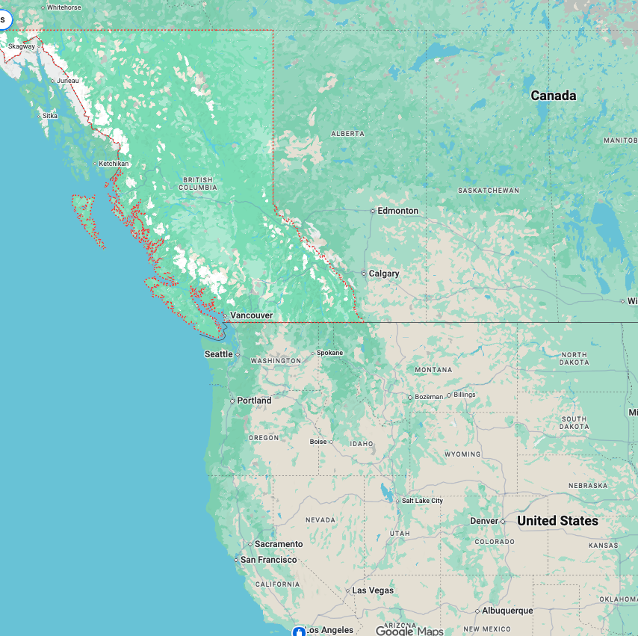
”Can you stay? Some people from way up north want to talk with you?”
Notes:
After the conference, Melissa asks me if I can stick around because she says, “Some people from way the hell up north want to come down and talk with you. Now, to get to the Upper Nicola valley you need to fly into Calgary, change planes, fly into Kamloops and then someone picks you up and you drive three hours. So, I am thinking, “My dear, YOU are way the help up north, but nope.

Slide 16

7 Gen Blocks came about because I could not help the teachers way up north revitalize their language.
Notes:
They were truly from somewhere up near the Arctic circle in a village of less than 1,000 people. They wanted a game to help revitalize their language. Lorraine Grey Bear, who worked with us on our games in Dakota, used to say that you don’t preserve a language, preservation is what you do with dead things in a museum – you revitalize a language. I truly wanted to help them but there was no way on earth that it was financially viable for us to make a game that would be played by at most 100 students a year. Since they were in Canada, I couldn’t get a grant from the U.S. for it.

Slide 17

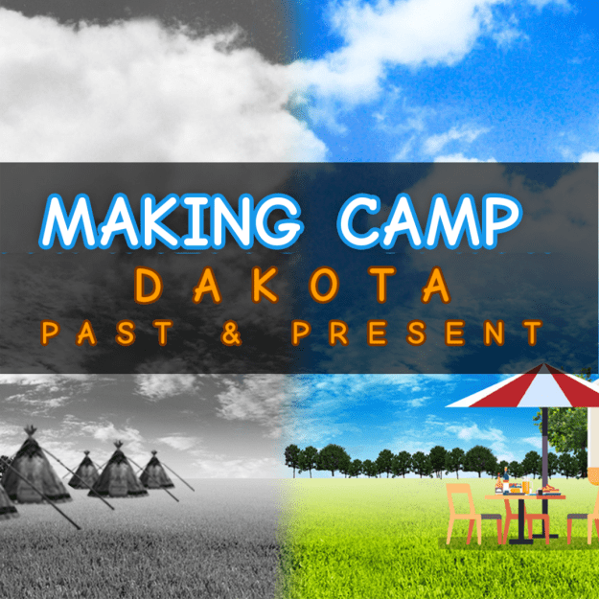
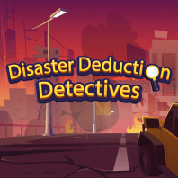
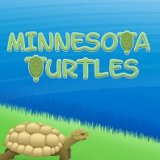
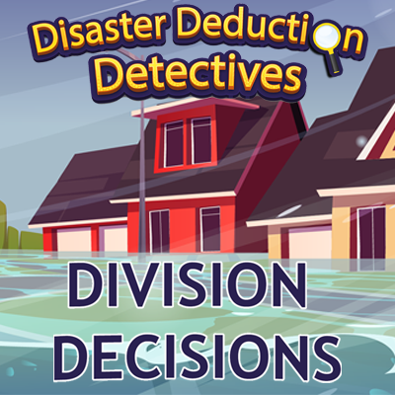
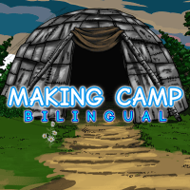
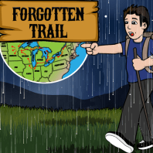
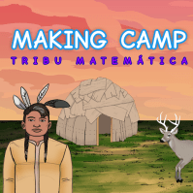
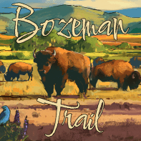
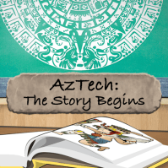

Notes:
We have made a lot of games, but it’s impossible for one small company to make a game not just for every Indigenous nation but to address the interests of kids in FFA, in rodeo, who are immigrants from Guatemala, whose first language is Somali or Nepali or Spanish or German.

Slide 18
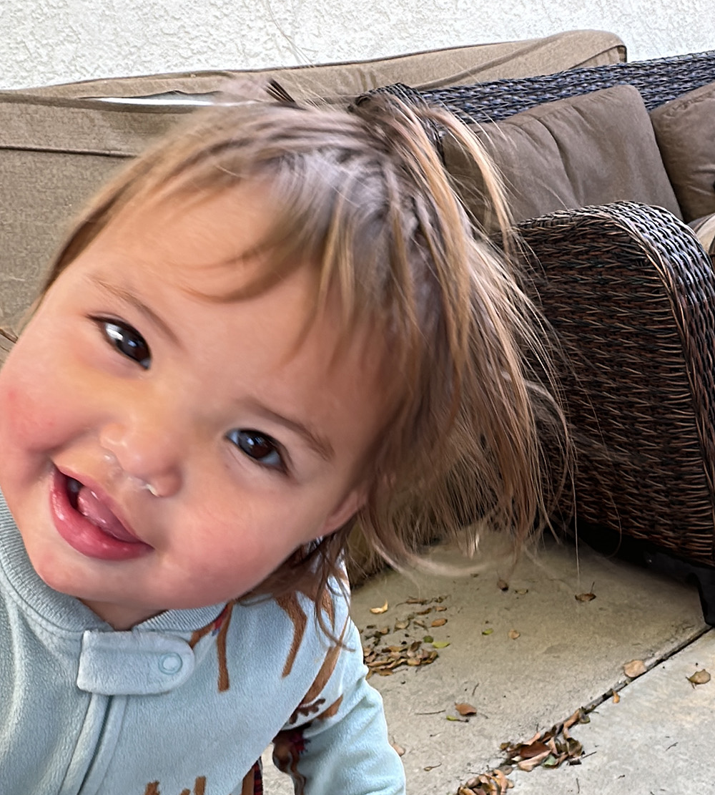

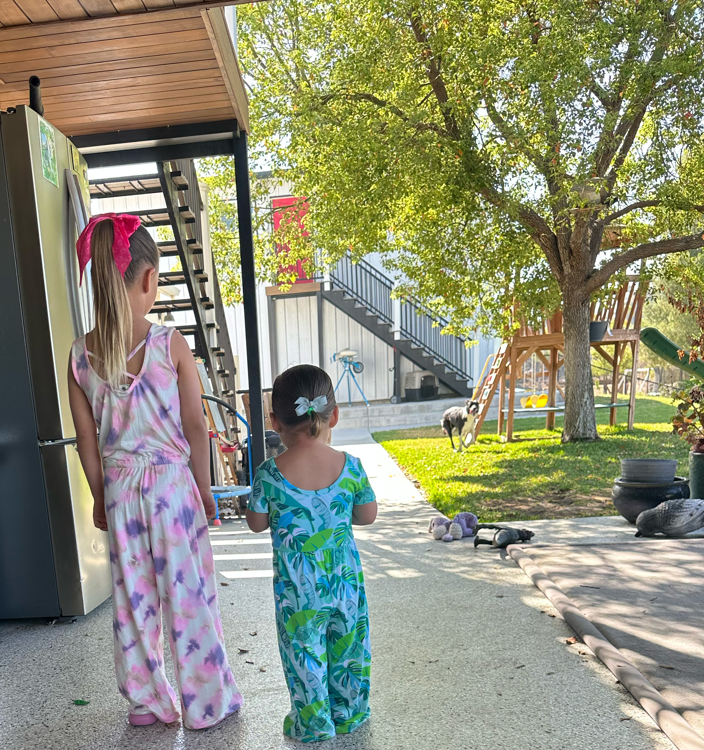
Children learn while playing*
“If making an educational game was as easy as writing a blog, educators could create games that reflected their community and language.”
* Adults do, too.
Notes:
This is partly an excuse to show pictures of some of my nine grandchildren – all of whom are adorable. It also draws me to the line Christy Hanson, our community manager at 7 Generation Games, would say, “Our language will not survive unless our children use it while playing.” Even for communities like the Lakota, or Native Hawaiians, like my grandchildren that are large enough to have some electronic media, it’s not enough. I have watched that Lava video approximately 487 times – but they love that video because it has volcanoes and lava

Slide 19
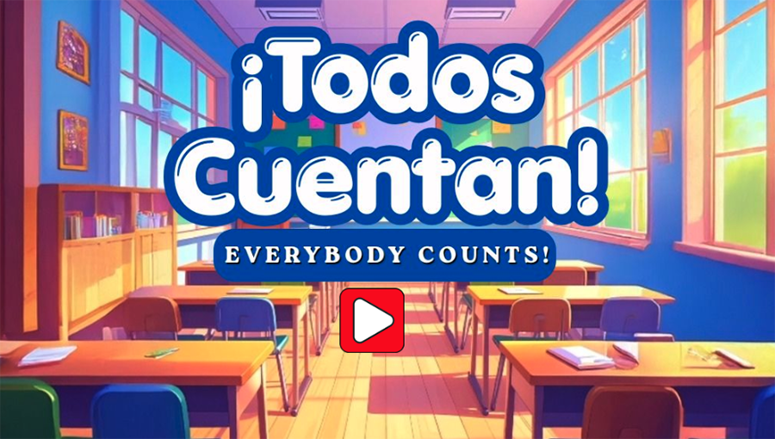
Designing your game
Notes:
First, you want to design your game. Anyone can do it. As the title of this game made by a teacher says, Everyone counts. I am going to give you a super fast intro to designing and making a game but I am also going to give you a whole bunch of resources and the link to these slides, so you can take your time and make your own game.

Slide 20
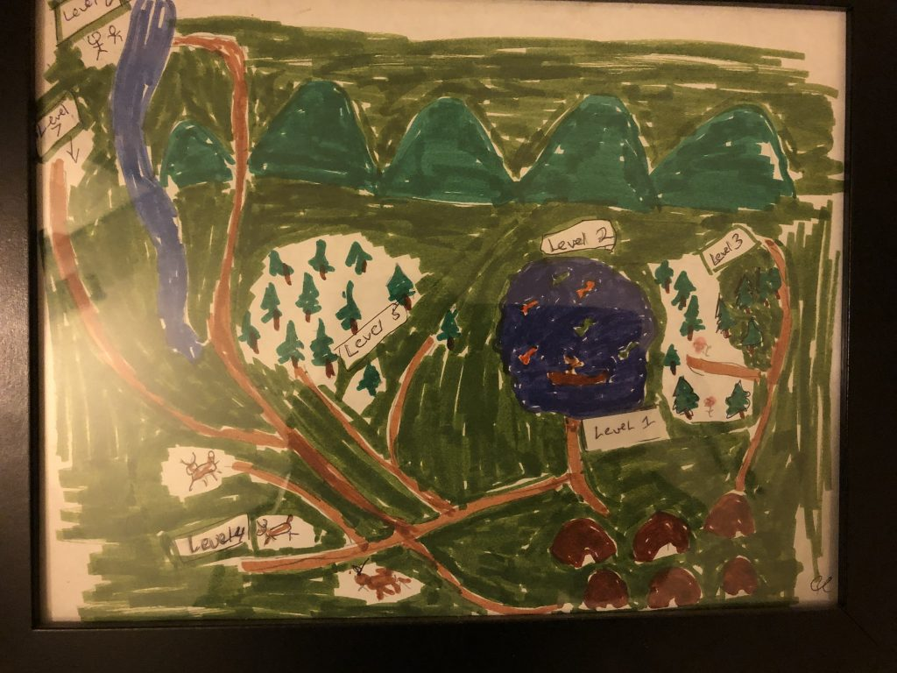
There is no right start
Start with research
  growingmath.org
  https://www.7generationgames.com/game_design/
Draw it out
Start with a back story
Begin with the narrative
What math, science, etc. do you want students to learn?
Game design cards
Notes:
Some of you are going to be better with art, some are better at writing. Some people do better starting with the big picture, like the narrative. I’ve generally found it helpful to play some games first, then do the game design cards, then either do a story, character back story, drawing or outline as suits you.

Slide 21
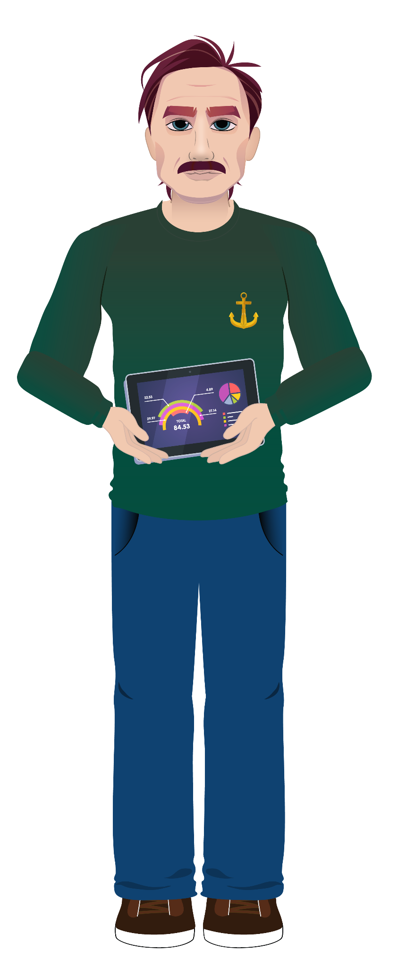



Diverse characters who just ARE
Notes:
Let’s talk characters. If I realize all of the main characters in my game are boys or girls, or all all the same race, I revise the design. I want kids to see themselves in a game.
Taylor is Metís. I don’t know if Taylor is a boy or a girl. When I told our artist that I needed a couple of kids from a game, since he’s from the Fishing Lake settlement, he looked out the window and drew a couple of kids. Taylor actually had an Anishanaabe name I couldn’t pronounce, so I changed the name to Taylor. The game teaches division of fractions and it’s called Bake it till you make it. Melissa is First Nations from the Upper Nicola band. The part of a game she was in was discussing salmon and she knows more about salmon than anyone I’ve ever met. The scientist from the USDA there is Navajo. If you’re Navajo and you hear the name Begay, no one needs to tell you where he’s from. Dr. Edwin is black. His voice over was done by the nephew of one of our developers. They’re all in a game that teaches basic statistics.

Slide 22
Some tools to get you started
AI - with or without images -
Write a factual summary of child labor in the U.S. from 1850-1925. Begin with the statement "In the late 19th and early twentieth century, the child labor laws we have today did not exist. Children could be found in many danger and difficult jobs. " Refer to the following images in your story.
https://www.loc.gov/resource/nclc.01151/
https://www.loc.gov/resource/nclc.00608/
https://www.loc.gov/resource/cph.3b43550/
Game design cards
https://docs.google.com/presentation/d/1zcHU52RU6flq89TwQFKaslYAbLJ6379YLTNwsk1dzZs/edit?usp=sharing
Notes:
AI prompts to START. I’ve often found examples, prompts, templates and sentence stems to be super helpful

Slide 23
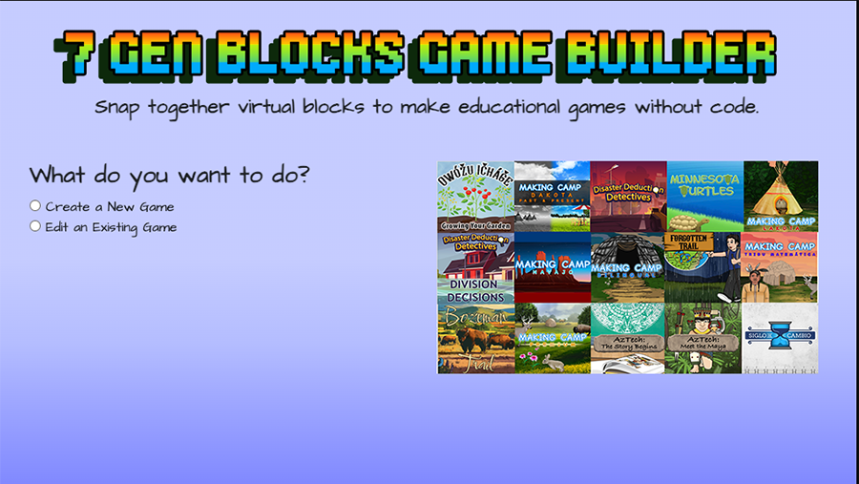
Notes:
Let’s take a quick look at our game builder

Slide 24
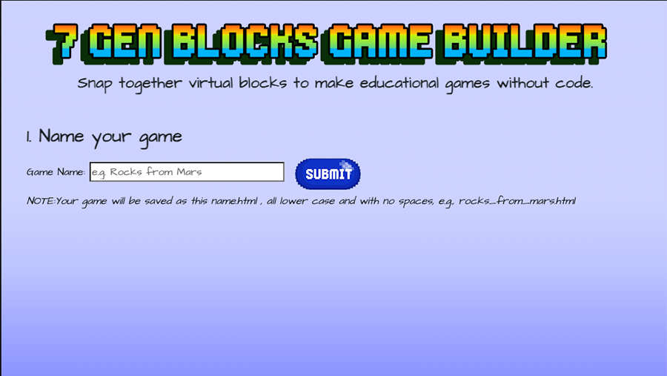
Notes:
Give it a name.

Slide 25
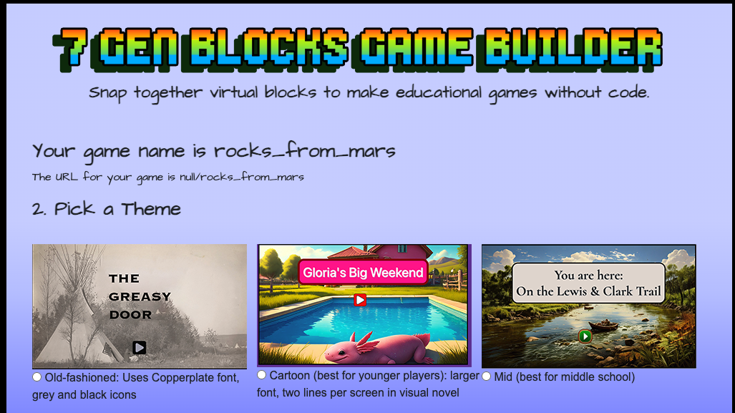
Notes:
Pick a theme, which will decide your colors of icons, size of text.

Slide 26
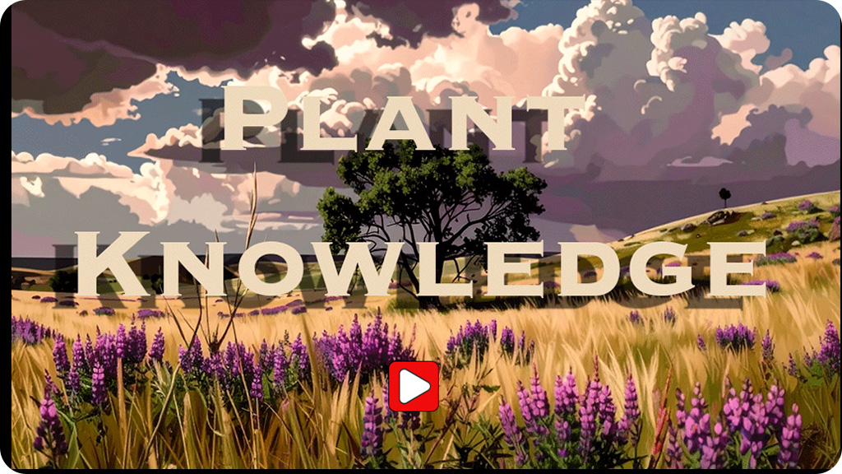
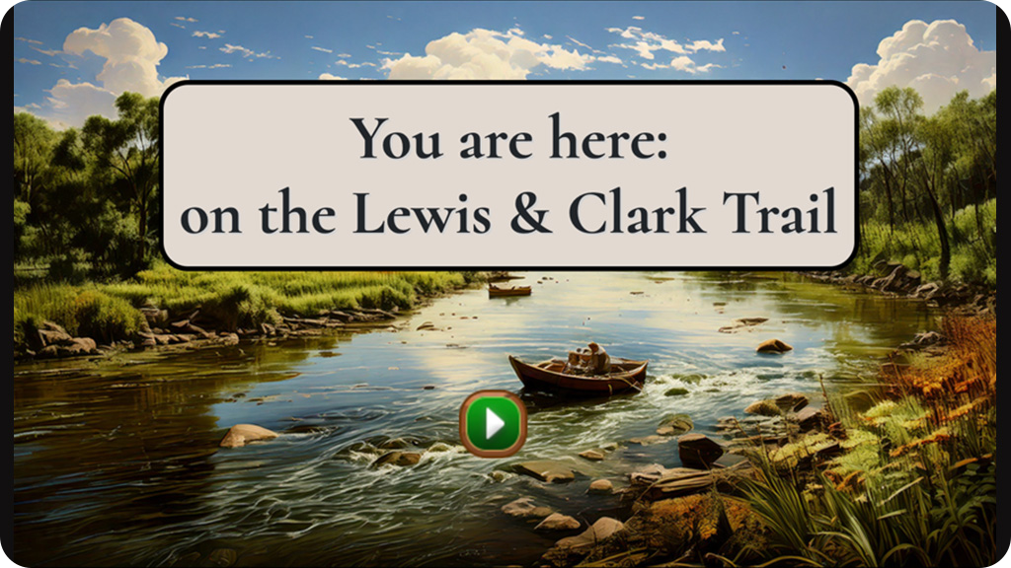
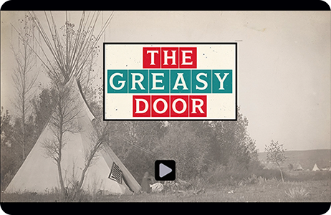
Splash screen = your title page
The first thing players see, every single time they start your game. Make it count.
10
Notes:
It was pointed out to me in a presentation earlier this year that not everyone is familiar with the term splash screen, so, now you know, that is going to be like the title page, the page that shows up any time they start your game.

Slide 27
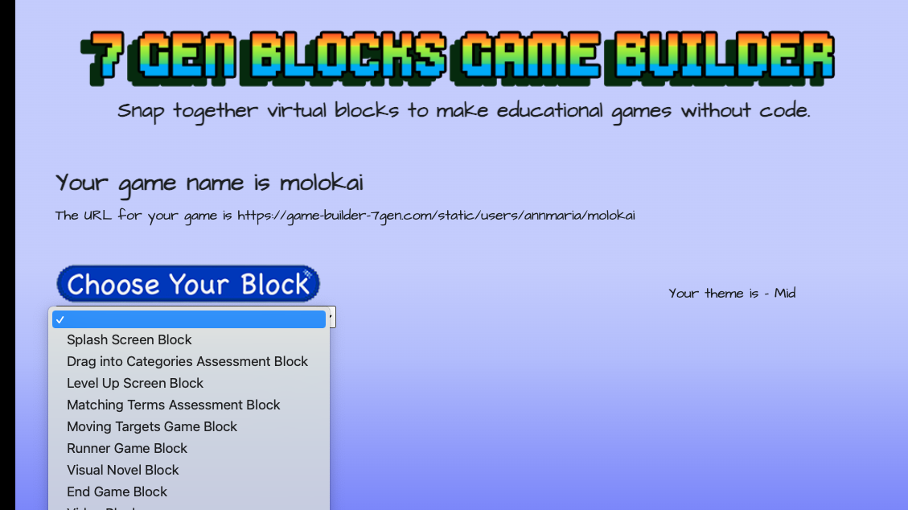
Notes:
Then you put together a game in blocks, kind of like snapping together Legos, starting with a title screen, then you can have graphic novels, a runner game moving targets, whatever you want. Every block works pretty much the same way.

Slide 28
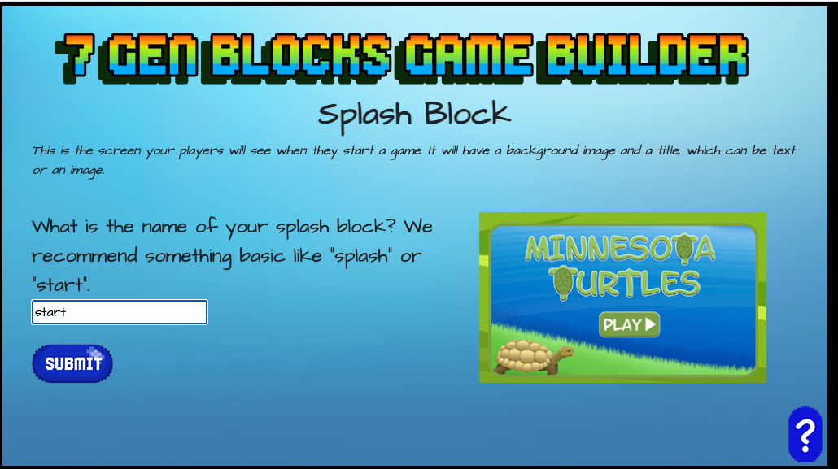
Notes:
Every block works the same. You name the block. Also, notice on the right will be an image what your block looks like.

Slide 29
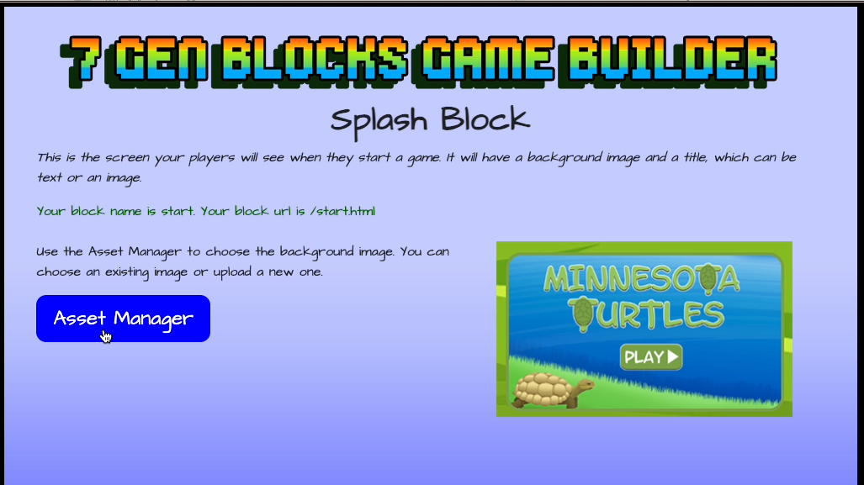

Slide 30
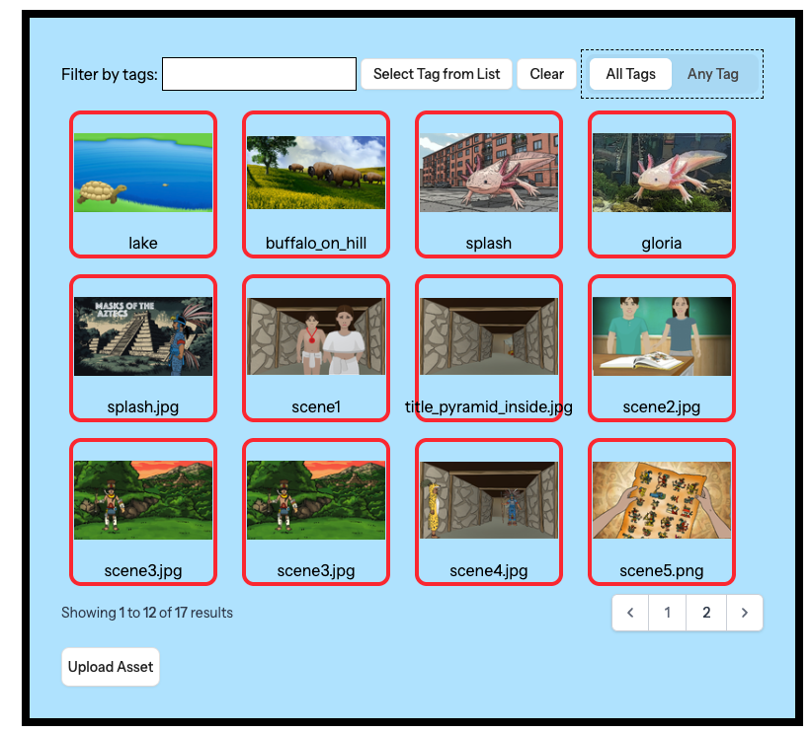
Click to select from images provided or upload your own images.

Slide 31
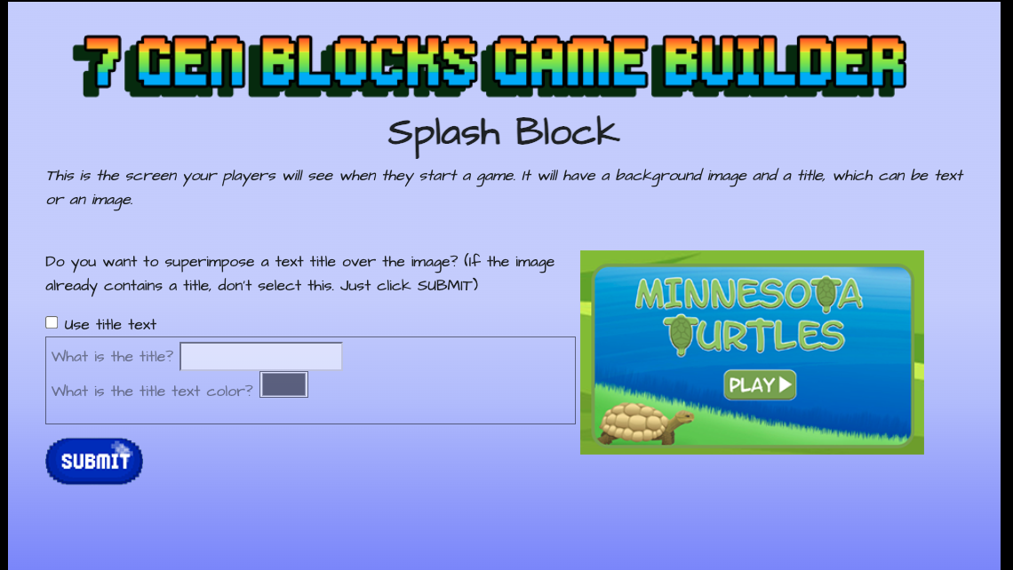

Slide 32
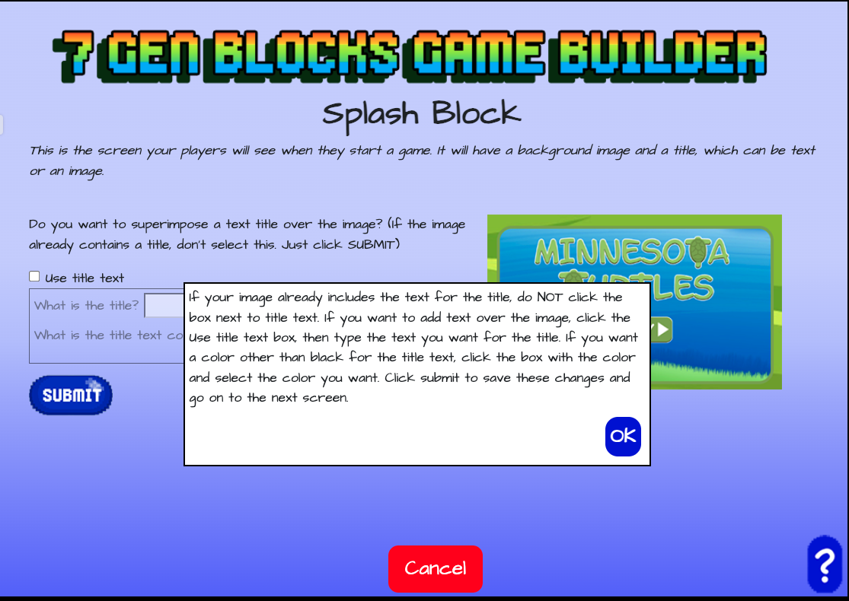
Notes:
Almost every page has a help screen. Just click the question mark

Slide 33


Slide 34

Notes:
Every block works the same. You name the block.

Slide 35

Notes:
You type text to answer prompts.

Slide 36
Notes:
At the end of each block, you’re asked for the name of the next block. It doesn’t matter if it doesn’t exist yet.

Slide 37

Editing is easy
Notes:
If you make a mistake, which we all do, you can edit your game just like this. Just click on an image to change it, delete and type new text to change that and click submit.

Slide 38

Get the Game Builder

Slide 39



Sites you’ll want to know
growingmath.org - Games , videos and lesson plans found here
7genblocks.com – Documentation and resources for the no-code game builder
https://game-builder-7gen.com/login Go straight to the game builder to start building
7generationgames.com – Blogs, news, games, customized development

Slide 40


https://www.youtube.com/@7GenBlocks/playlists
https://7genblocks.com/
Notes:
If you’d like to learn more, we have a youtube channel, a website

Slide 41

Sites you’ll want to know

Slide 42

Contact me!
AnnMaria De Mars, Ph.D. annmaria@7generationgames.com

